Slide 1

Capstone Design (2)
Team 11 - User Manual
Date | 2019.06.10
Version | 0.1

Slide 2
Index
Web Manual
App Manual

Slide 3
Web Manual

Slide 4
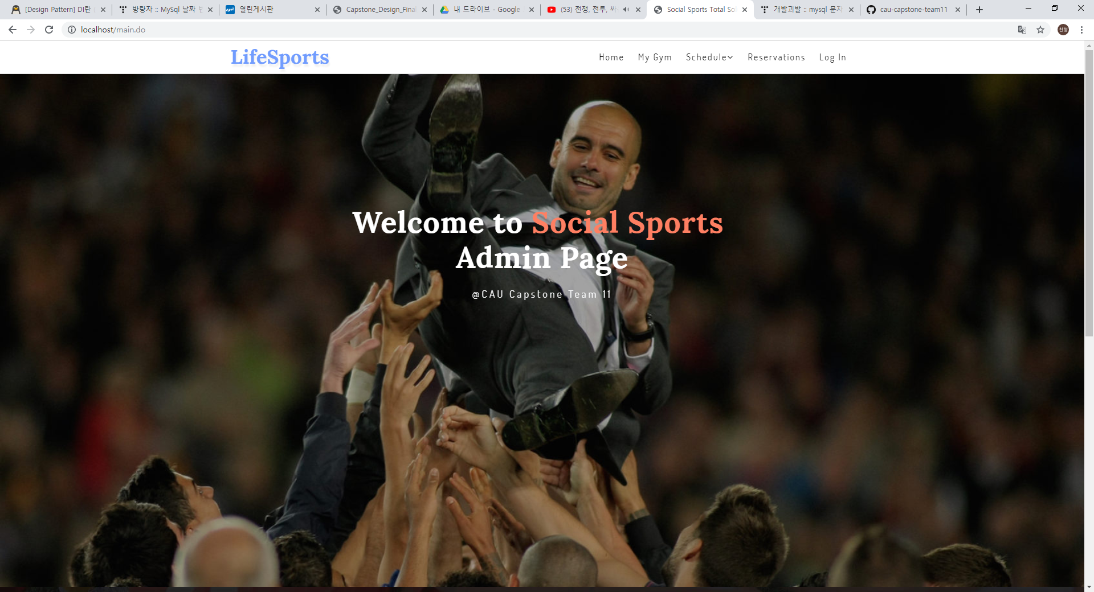
1. Web Service Tutorial
This is main page.
Click the login button on the upper right to use the function.

Slide 5
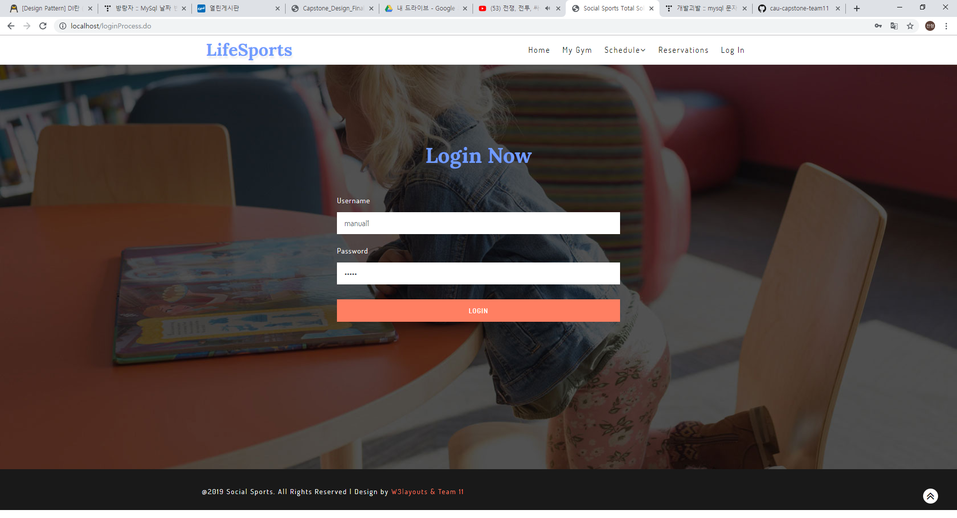
1. Web Service Tutorial
Please enter your username and password.
Manual IDs are set to manual1, manual2, and passwords are set to admin, respectively.

Slide 6

1. Web Service Tutorial
Manual 1 You are logged in with an ID.
Now press the My gym button to register your gym.

Slide 7
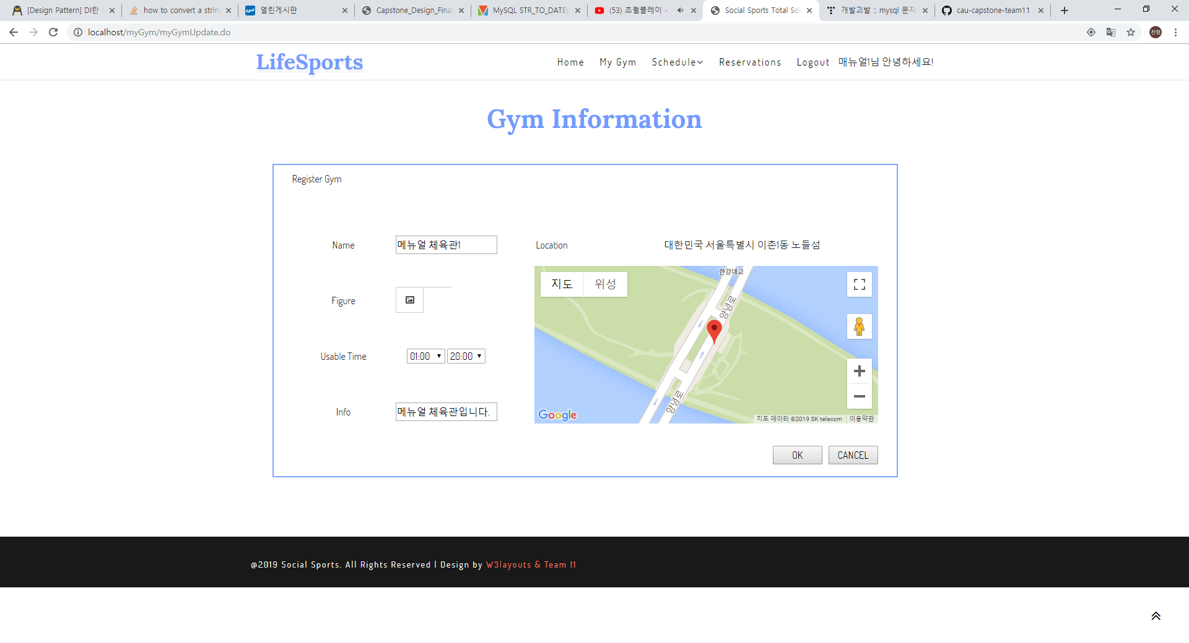
1. Web Service Tutorial
Complete the following:
Basically, drag the map that is designated as the current coordinates to select the location, and double-click to confirm the coordinates.

Slide 8
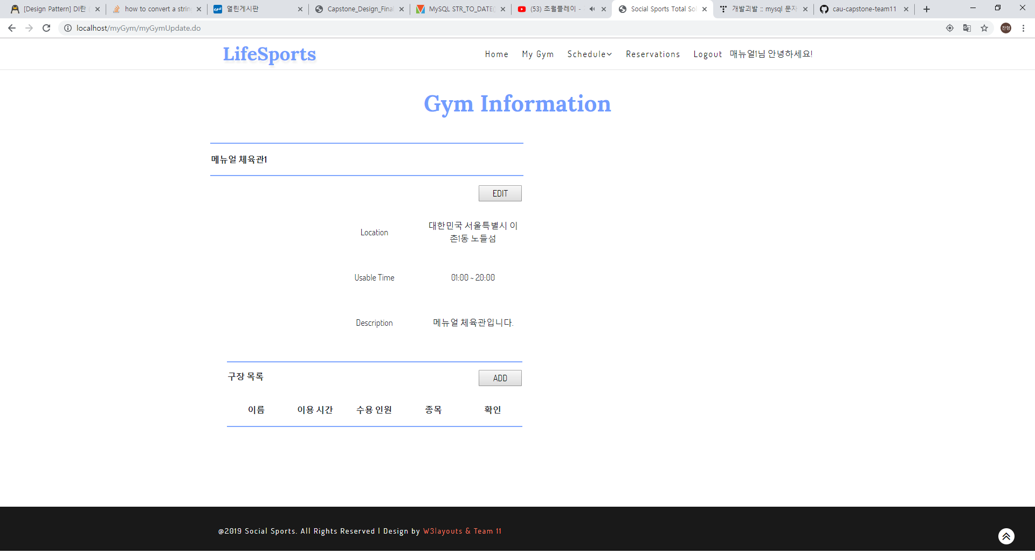
1. Web Service Tutorial
Once the gym is registered, register the facility.
You can modify the information by clicking the Edit button in the upper right corner, or you can add facilities by clicking the ADD button in the lower right corner.

Slide 9
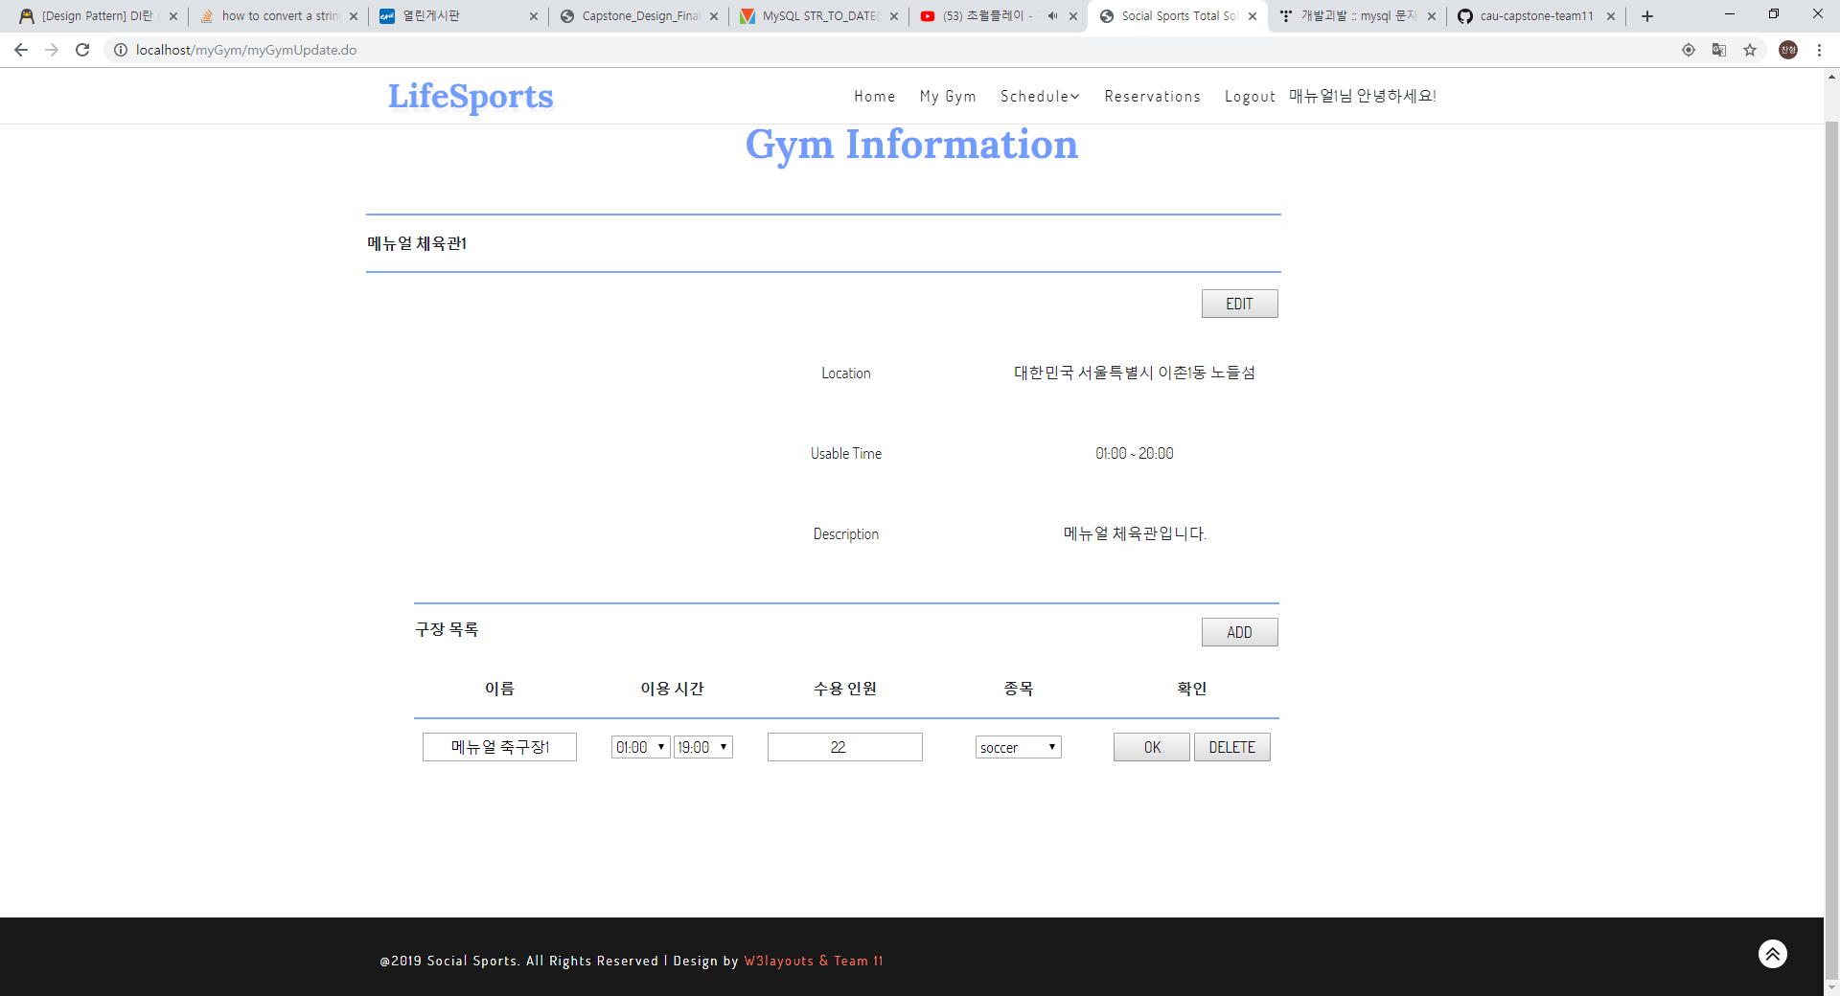
1. Web Service Tutorial
Click the ADD button, enter the required information on the form, and then click the OK button to register the facility.

Slide 10
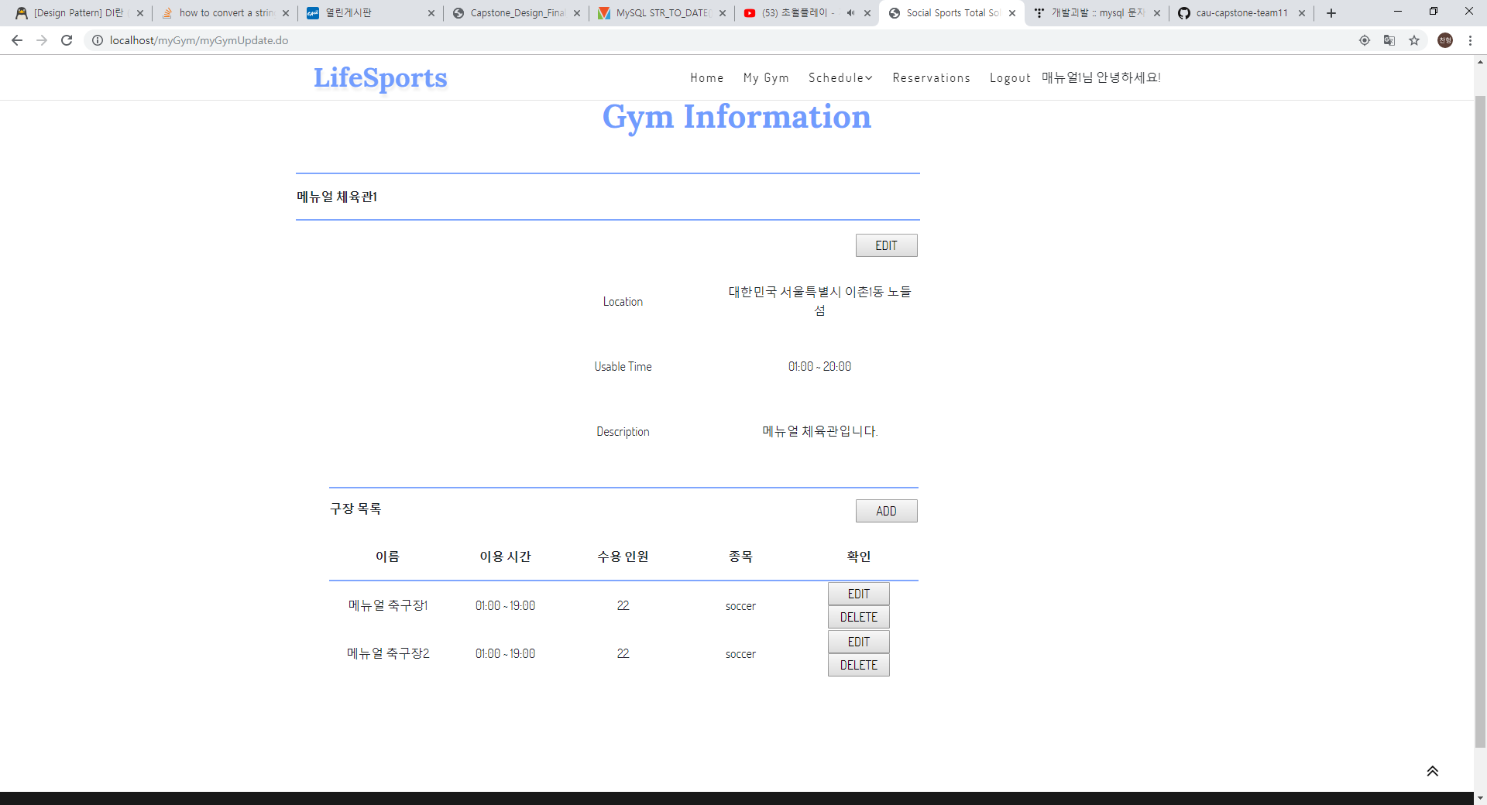
1. Web Service Tutorial
In addition, you may register multiple facilities.

Slide 11
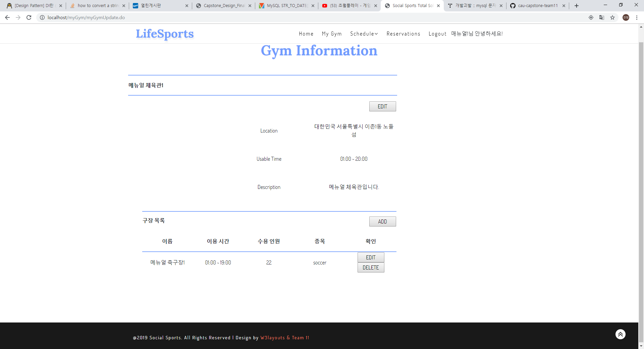
1. Web Service Tutorial
It is appearance that registered facility.
It's time to register your schedule. Click the Schedule button in the top menu bar to register the schedule.

Slide 12
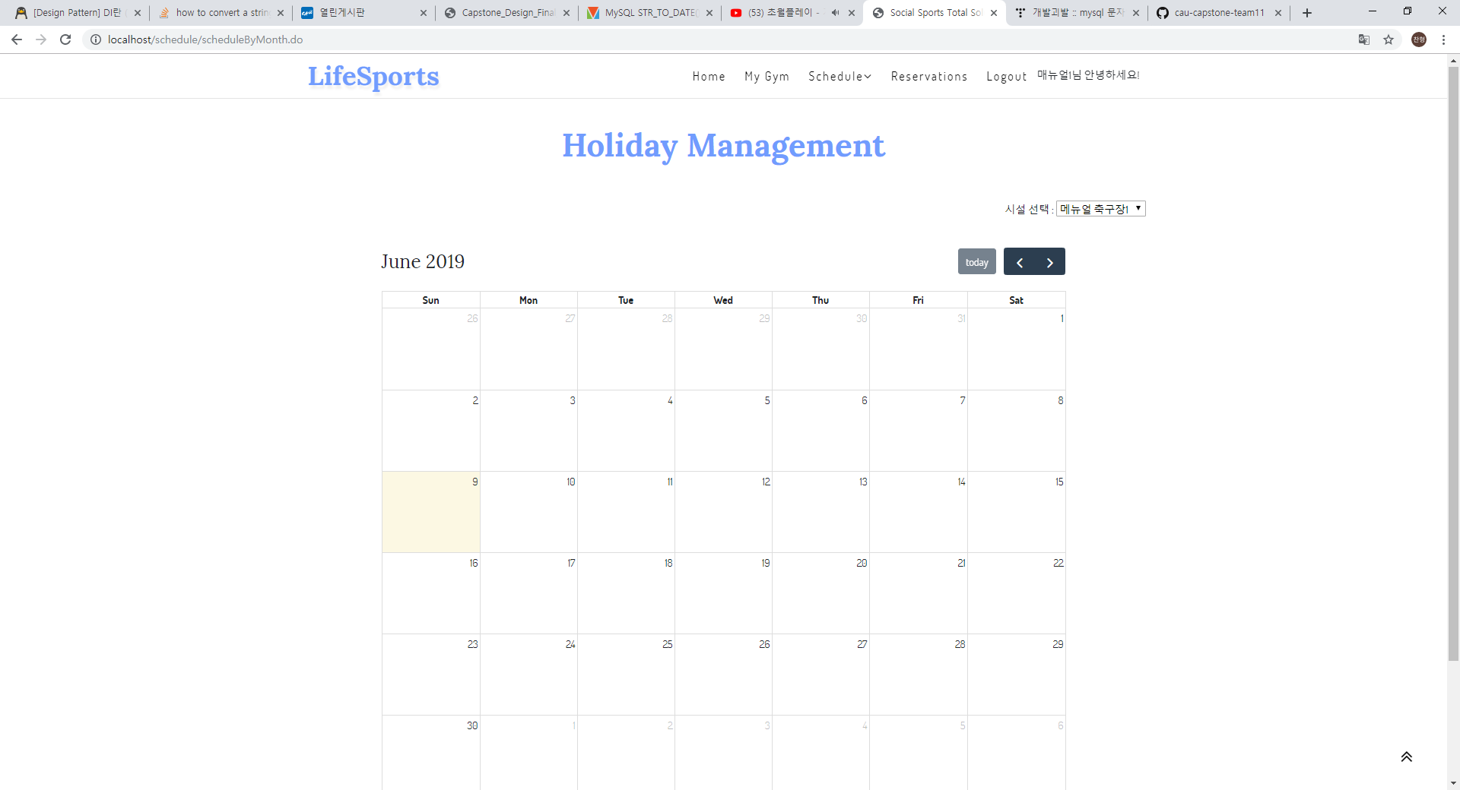
1. Web Service Tutorial
First, we register holiday.
Select the facility to register for the holiday from the drop-down bar on the upper right, and click on the date to register the holiday.

Slide 13
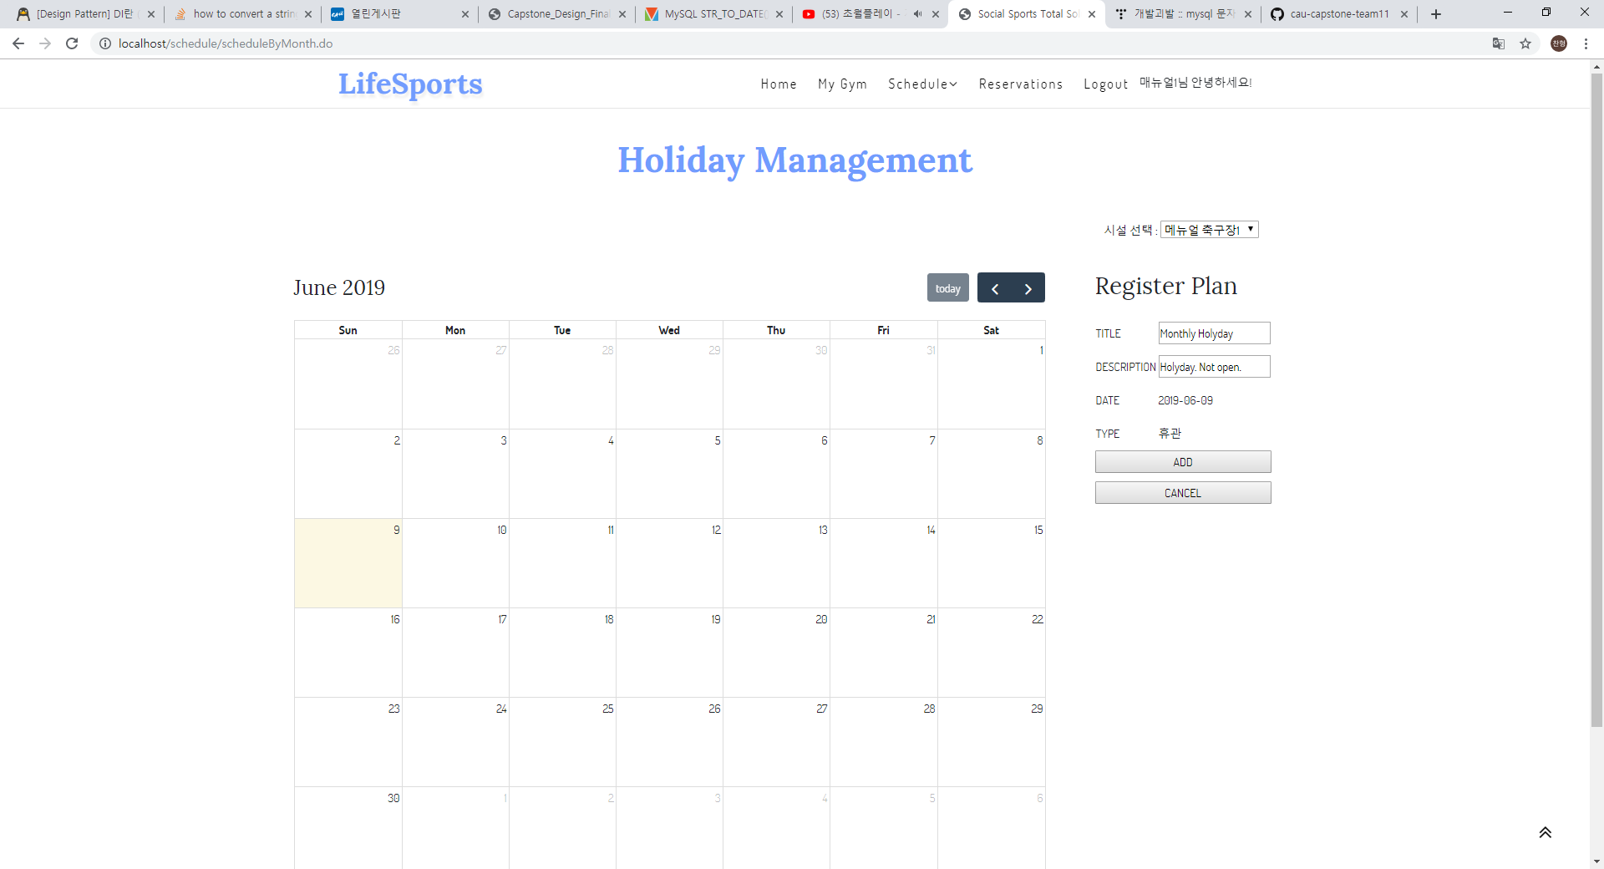
1. Web Service Tutorial
Enter the required information for the holiday registration and click the ADD button to register the holiday.

Slide 14
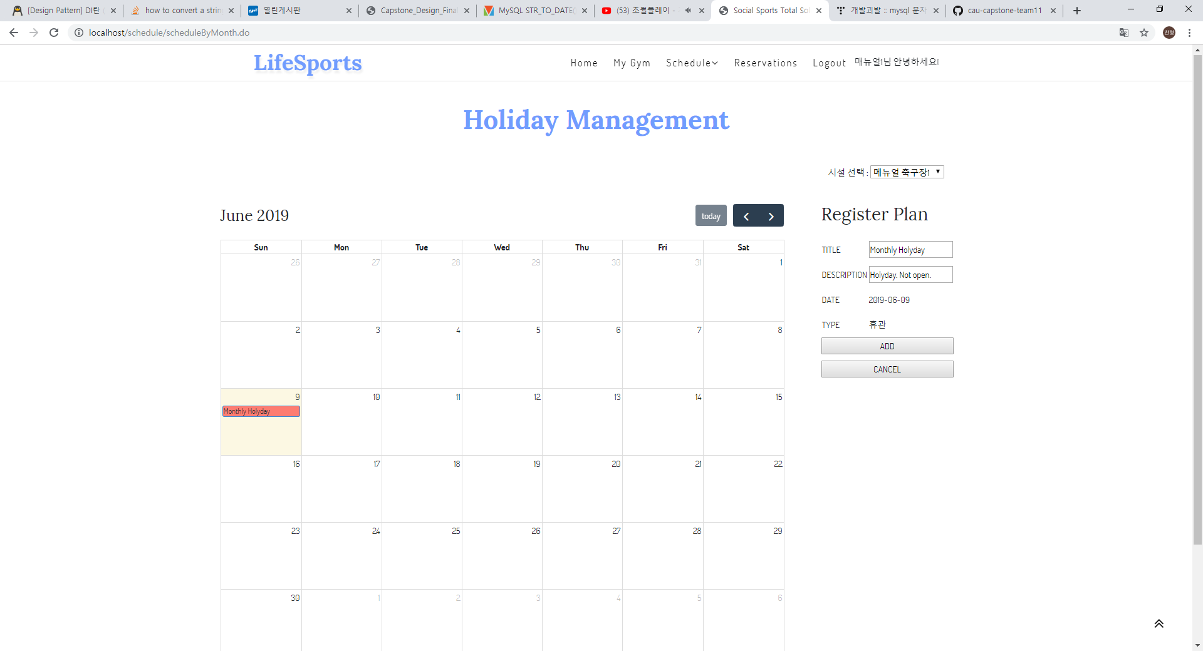
1. Web Service Tutorial
The holiday is registered successfully.
Now, click the Schedule Management tab on the upper Schedule button to register the schedule.

Slide 15
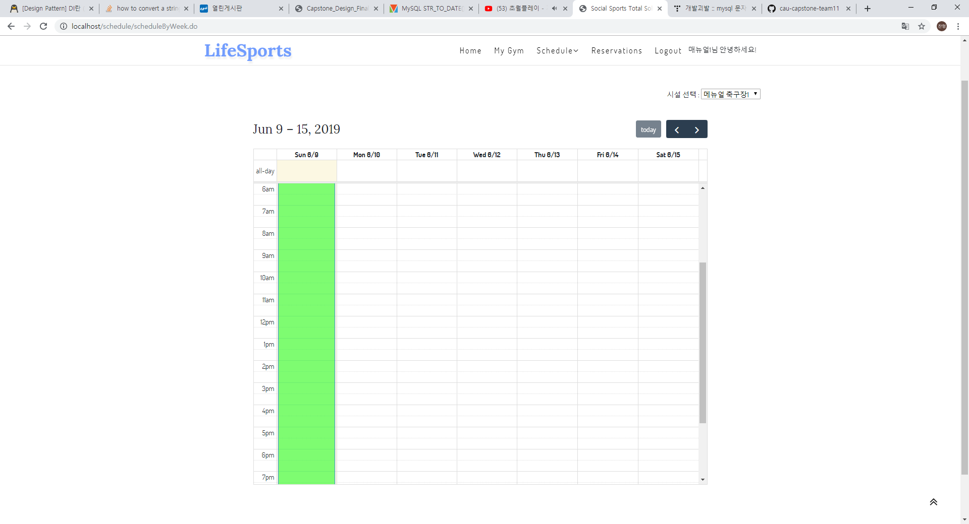
1. Web Service Tutorial
The holiday is registered.
You can not register a schedule for this holiday.
It's time to register your schedule.
Try to specify the time and date by dragging the desired time.

Slide 16
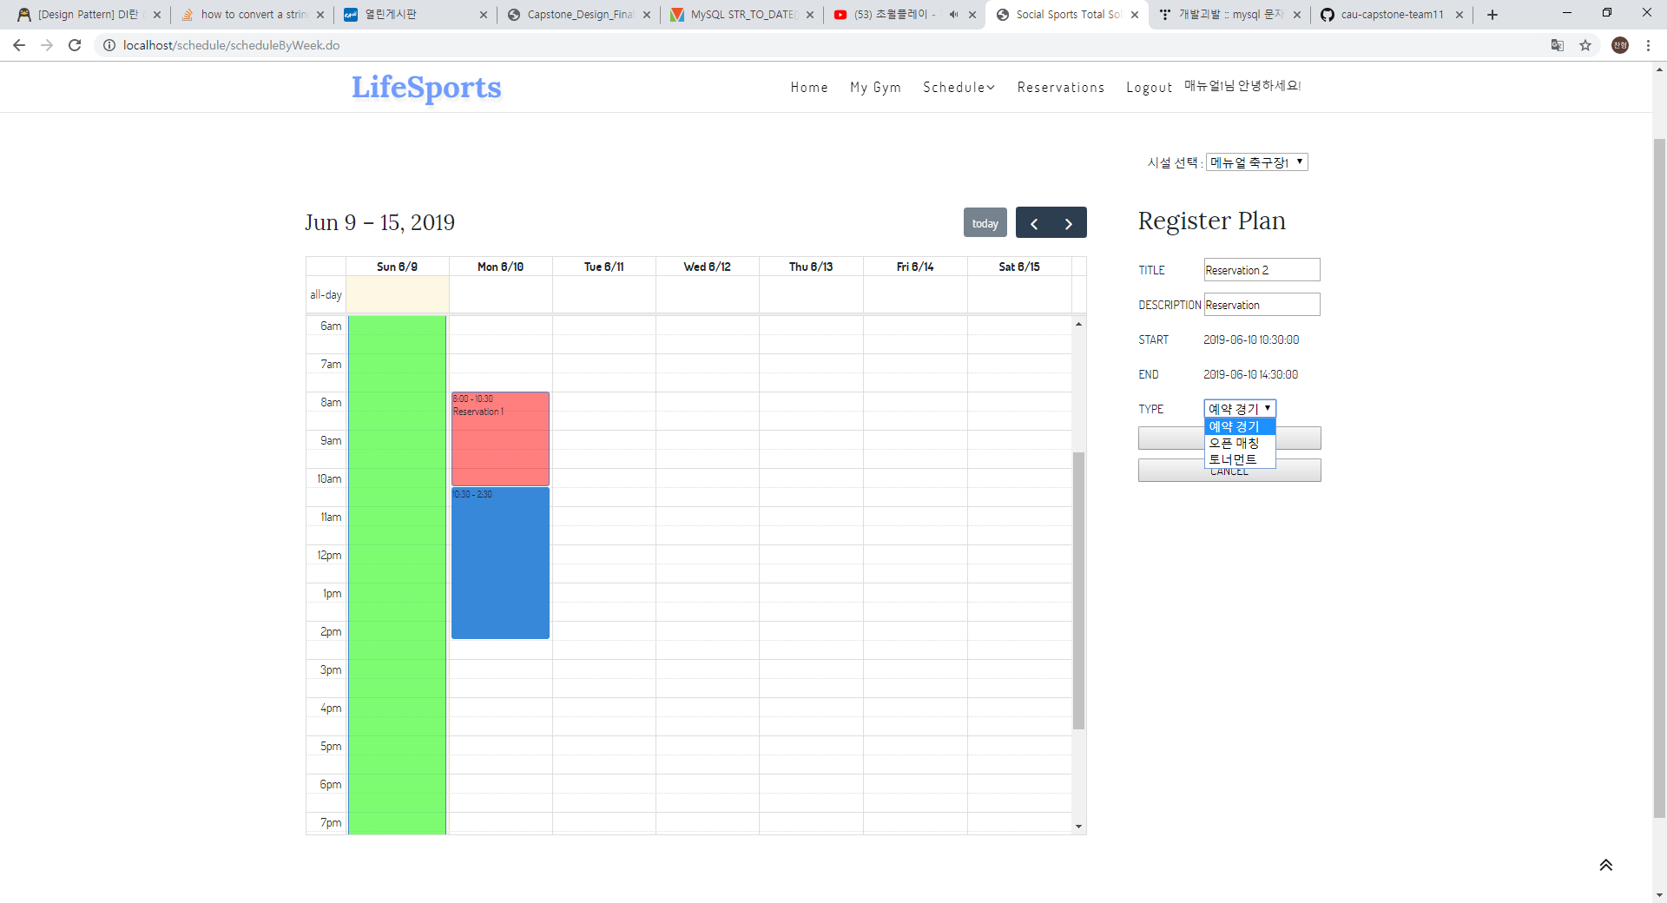
1. Web Service Tutorial
I registered two games.
As before, enter the information you need to register for the event.

Slide 17
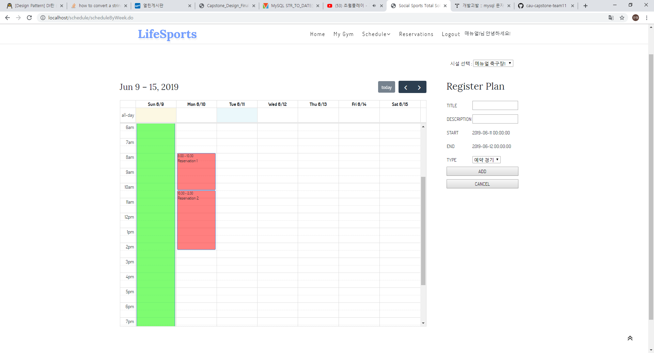
1. Web Service Tutorial
Two games are registered.
Now it's time to register for Open Match.

Slide 18
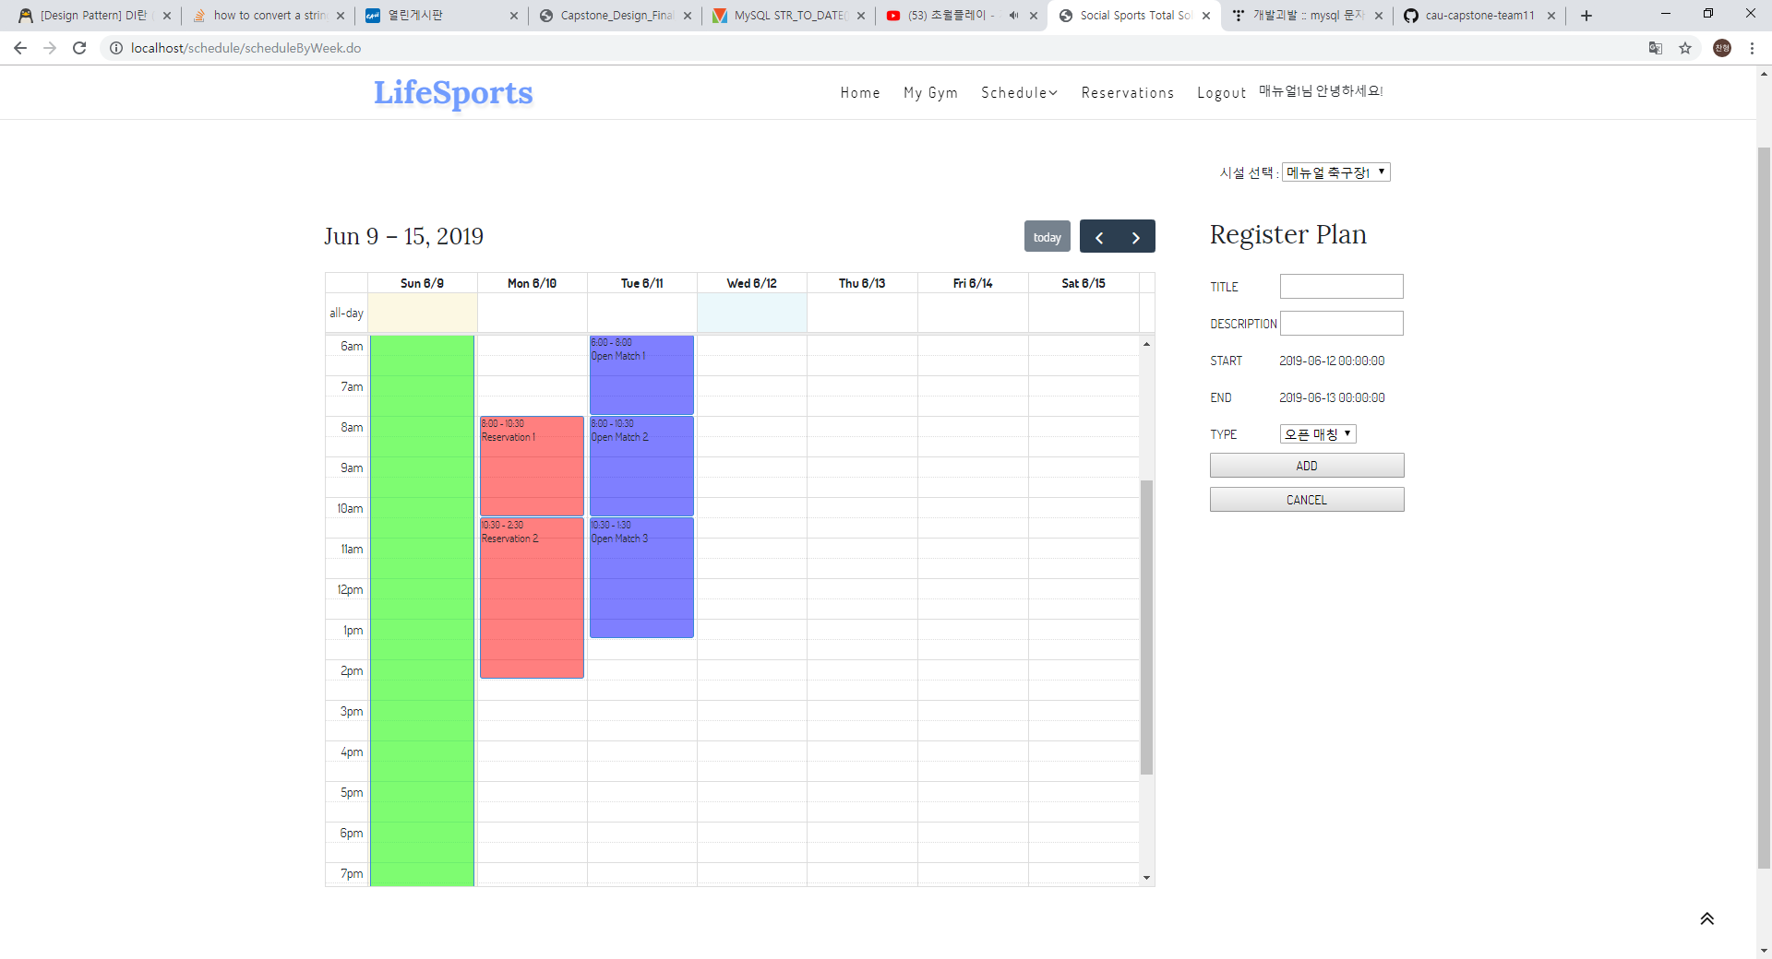
1. Web Service Tutorial
Closed, booked matches, open matches are all registered.
The specified schedule can be checked by the application.
Now it's time to register for tournament posts. Click the Tournament button on the Schedule button in the upper right corner.

Slide 19
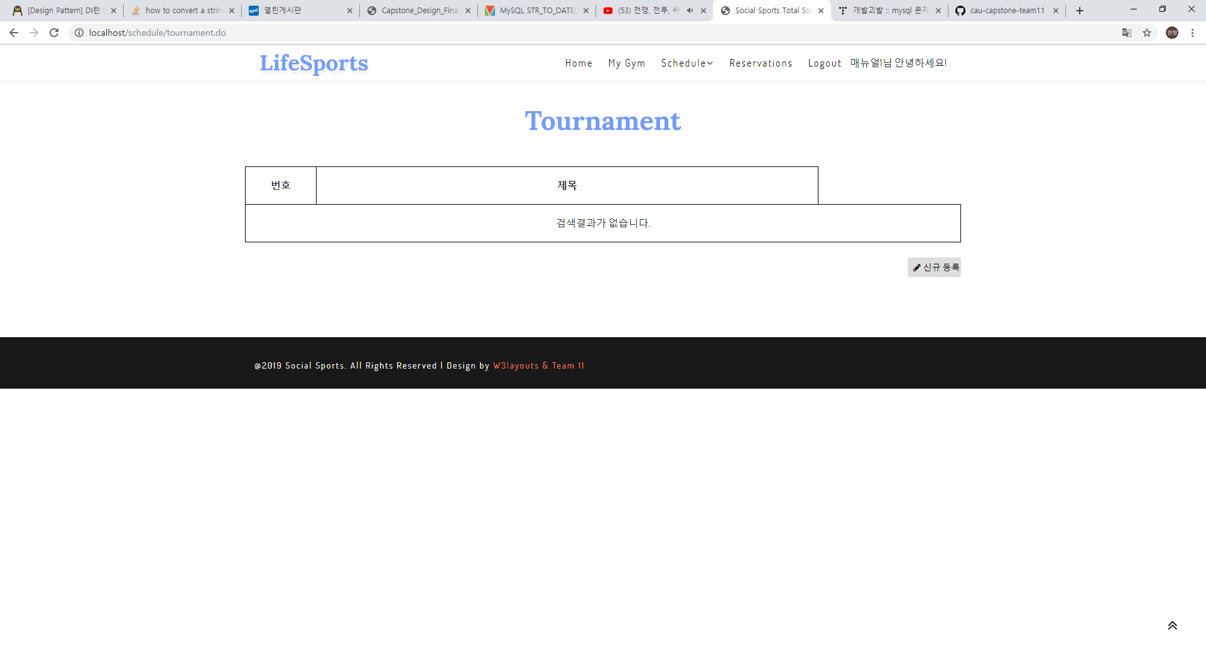
1. Web Service Tutorial
Let's register a new tournament post.
Click the New Registration button in the upper right corner.

Slide 20
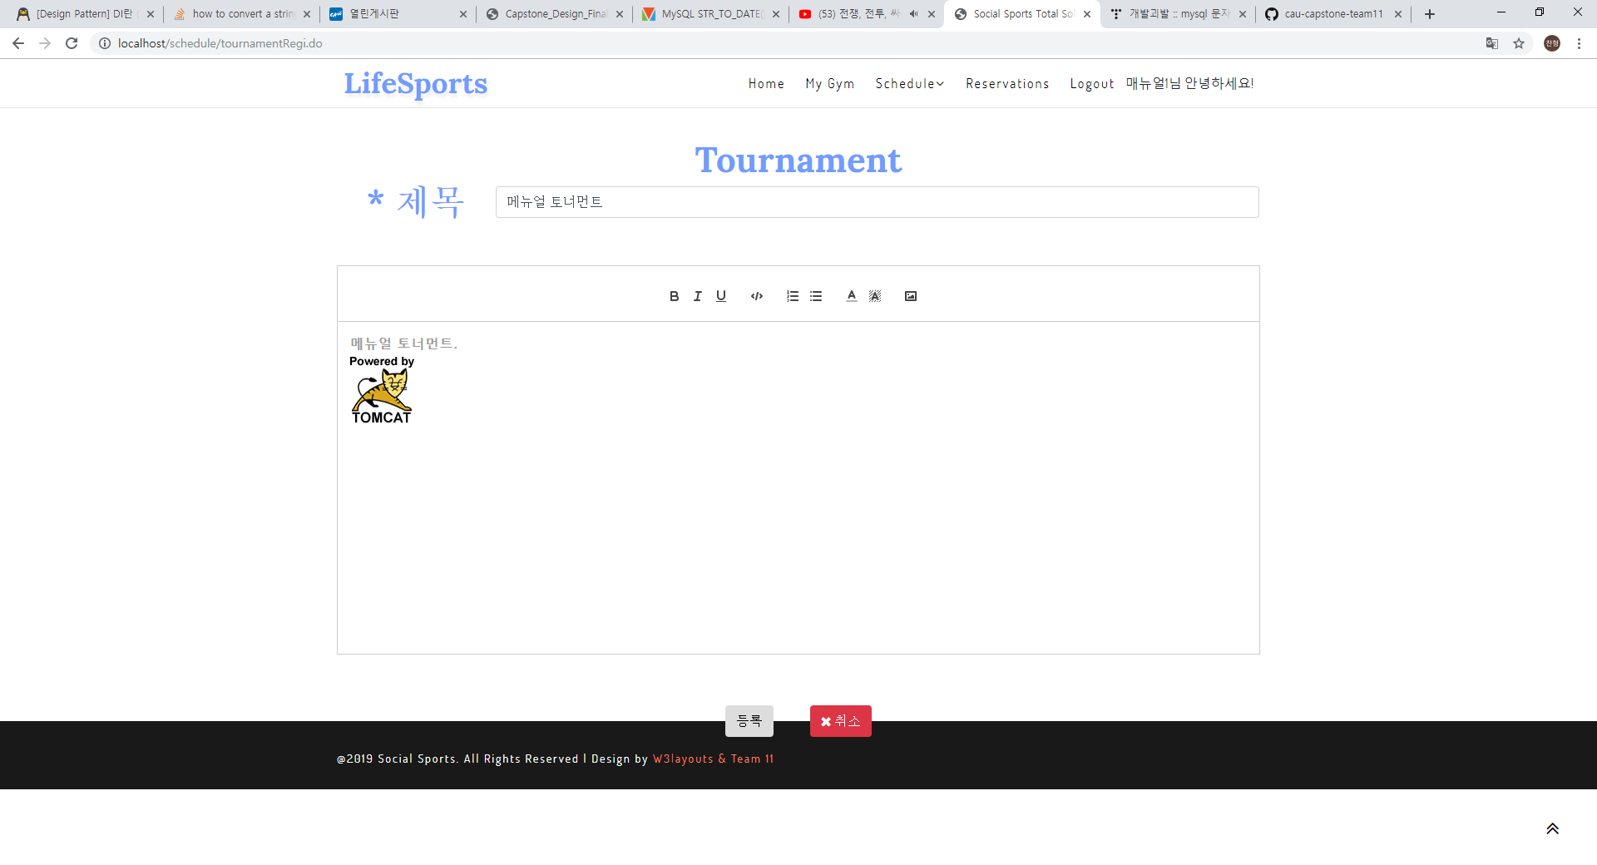
1. Web Service Tutorial
Enter the required information for the post.
You can underline, bold, underline, attach photos.
After completing the registration, click the Registration button at the bottom to register.

Slide 21
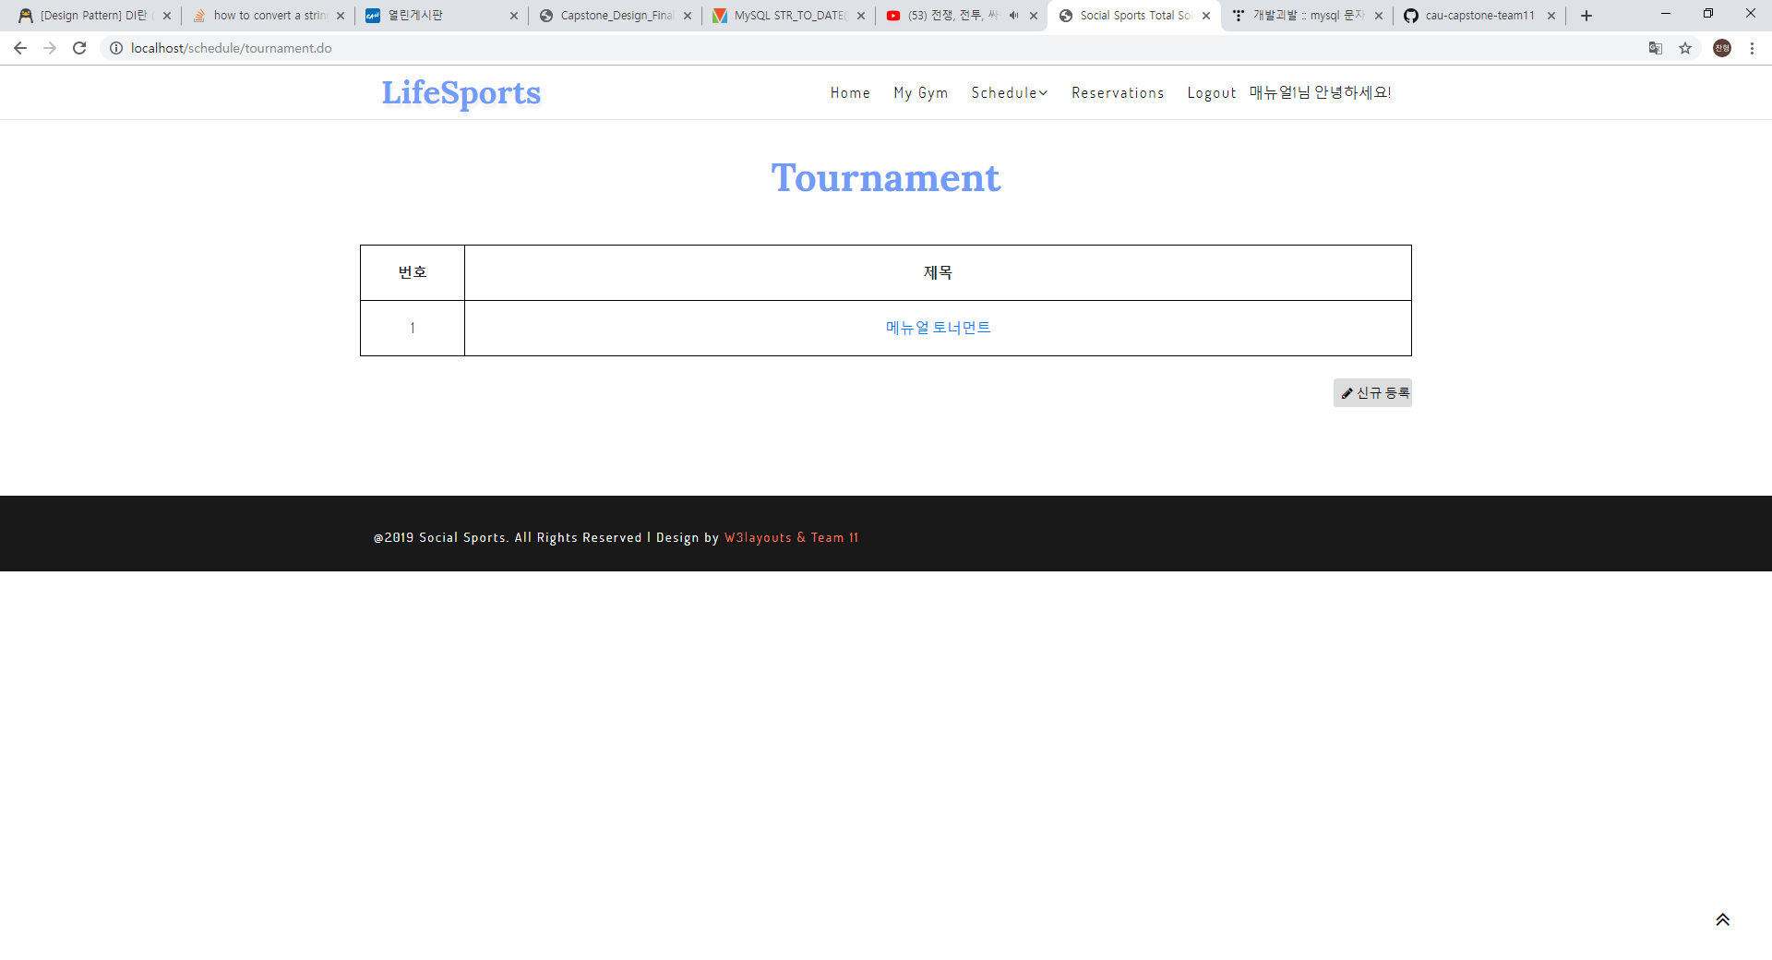
1. Web Service Tutorial
New posts added!
Click on the title to see if it is registered properly.

Slide 22
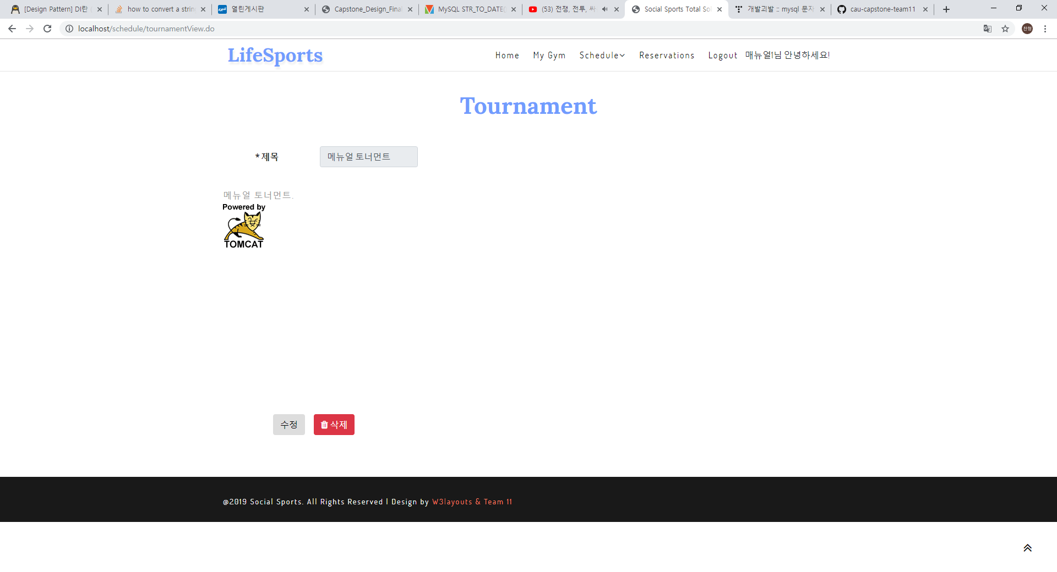
1. Web Service Tutorial
You are properly registered.
Now let's finish all the tutorials and log out.

Slide 23
1. Web Service Tutorial
Click the top right logout button.

Slide 24

1. Web Service Tutorial
Congratulations!
You have been successfully logged out.

Slide 25
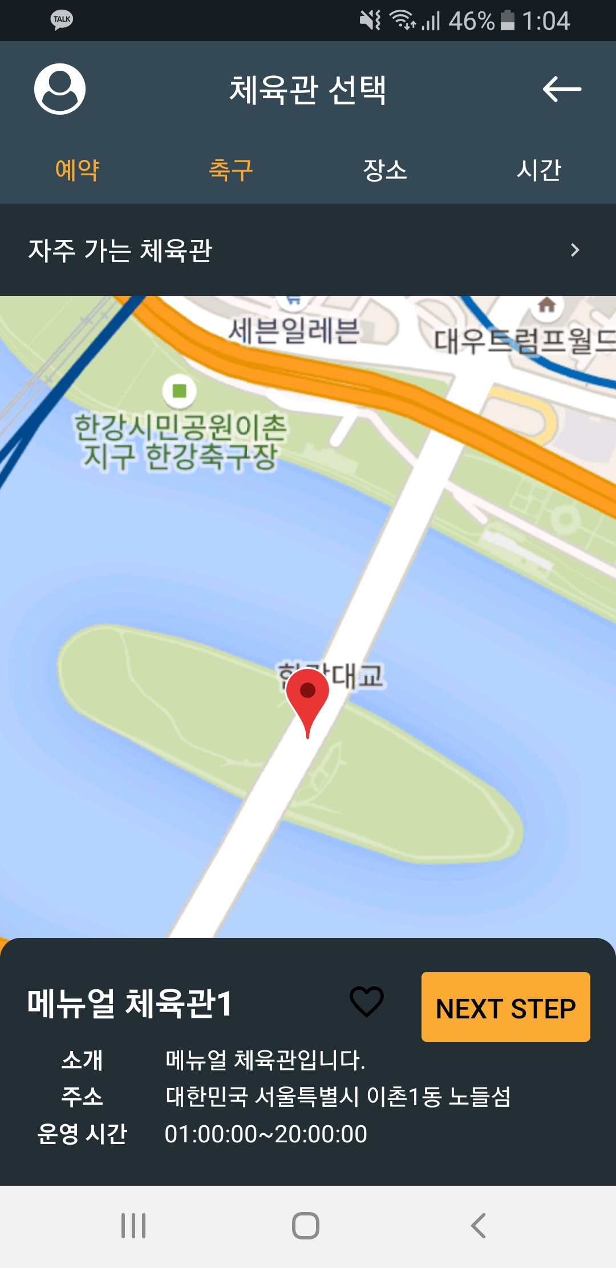
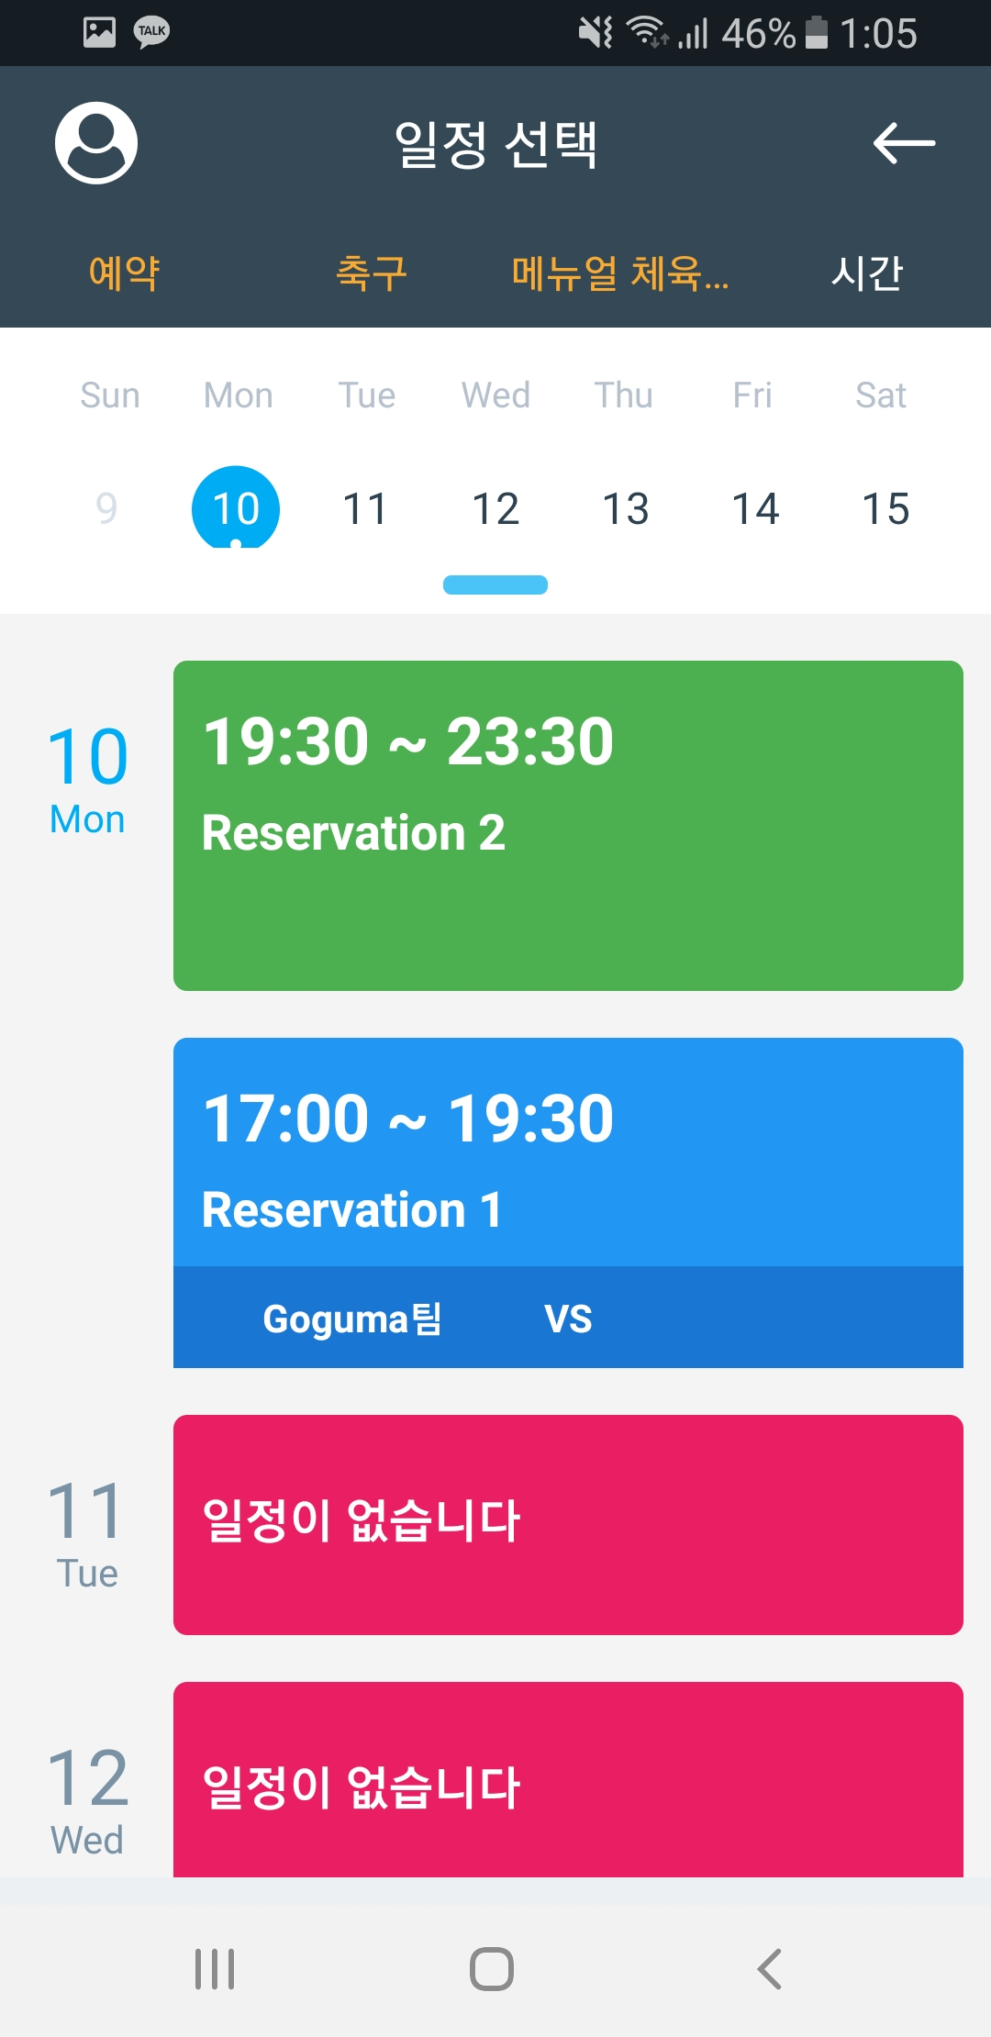
1. Web Service Tutorial
You can see that the Web and App work together
Manual Gym 1 is newly registered on Nodul Island.
A schedule has been added to the manual gym

Slide 26
App Manual

Slide 27
1. Screen Flow Chart
Screen flow chart
HeaderInfo
Login
Register
Register2
Mypage
MainIndividual
ReservationStatus
MatchingStatus
SelectType
SelectSports
SelectRegion
FavoriteGymList
SelectPlan
ReservationCheck
JoinPlayerList
JoinPlayerDetail

Slide 28
1. Screen Flow Chart
MainMyTeam
TeamInfo
TeamGameResult
ResultDetail
TeamMemberList
TeamMemberDetail
MainTeam
Recommend
There are 3 entries in total

Slide 29
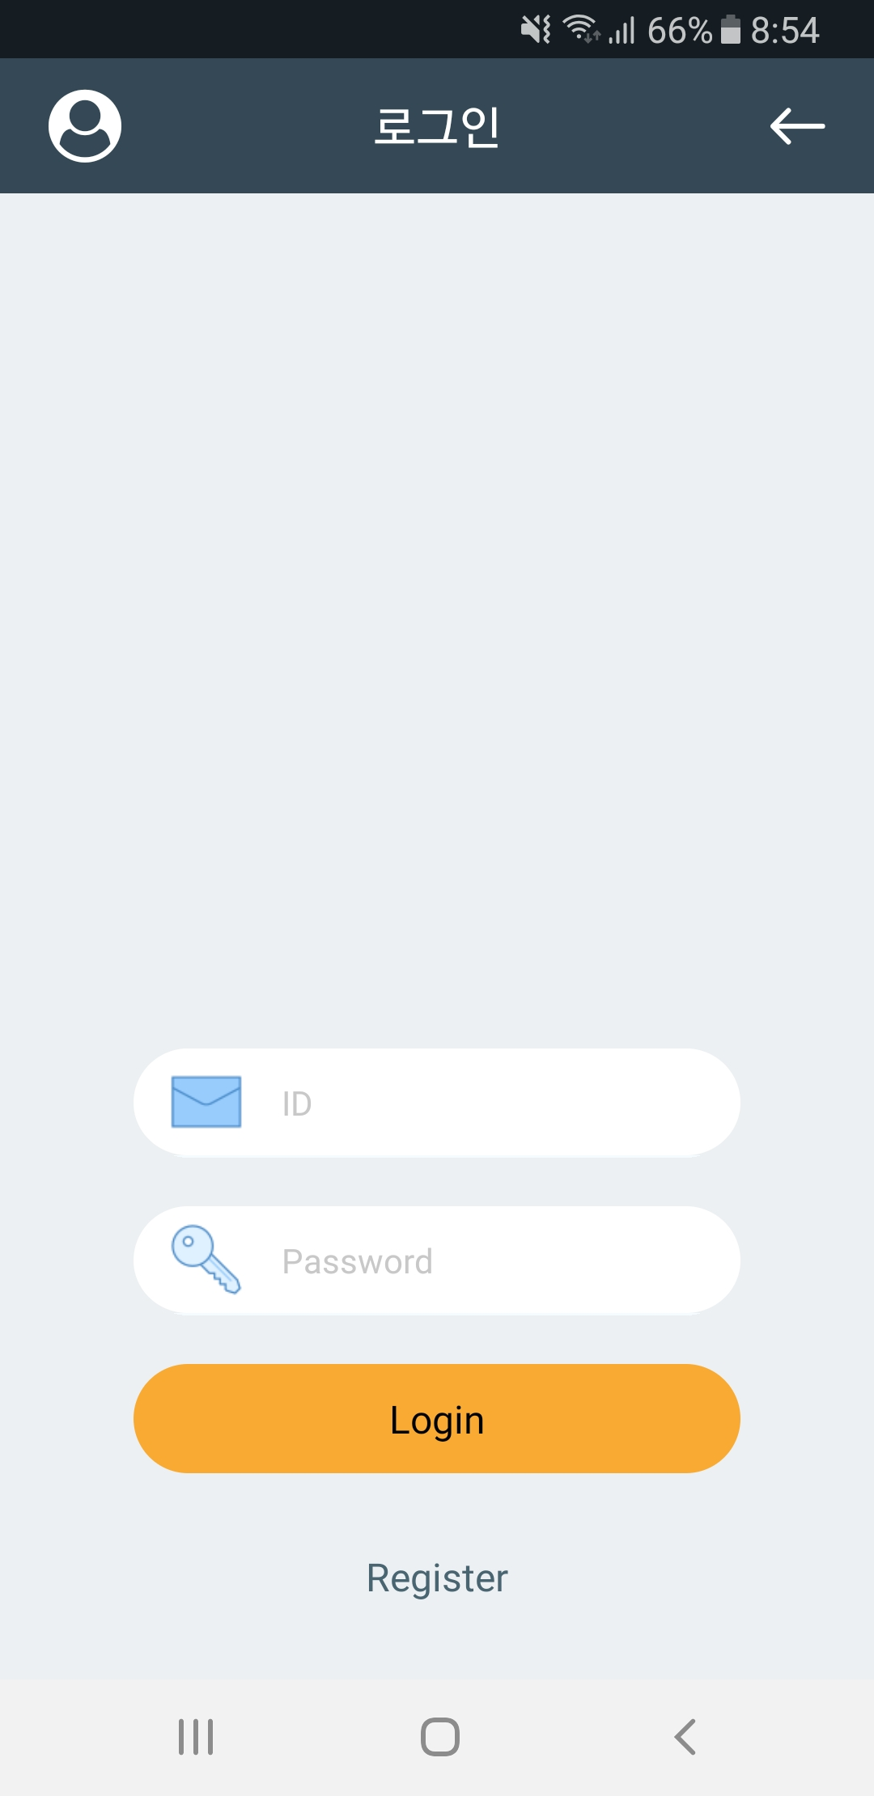
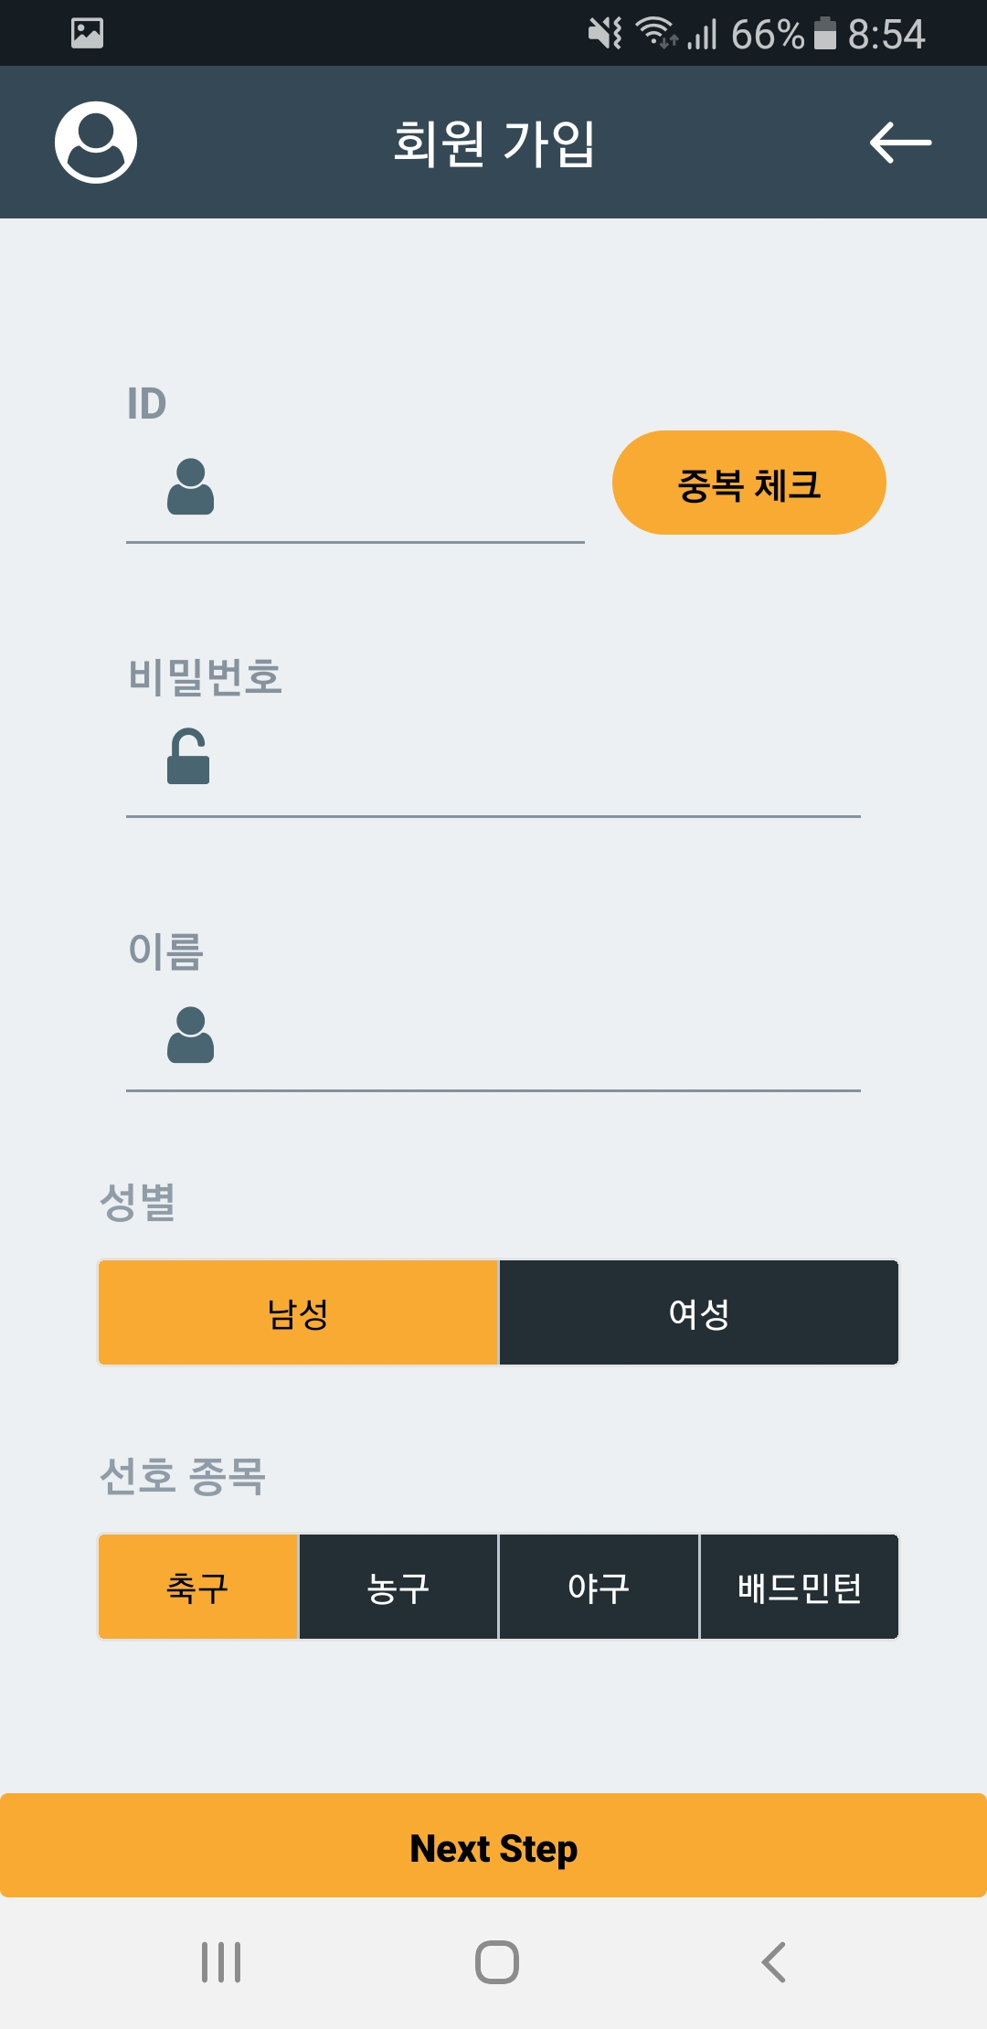
2. Screen Manual : Login
Please enter ID and PWD.
Proceed to login
Go to Membership Screen
1
2
3

Slide 30
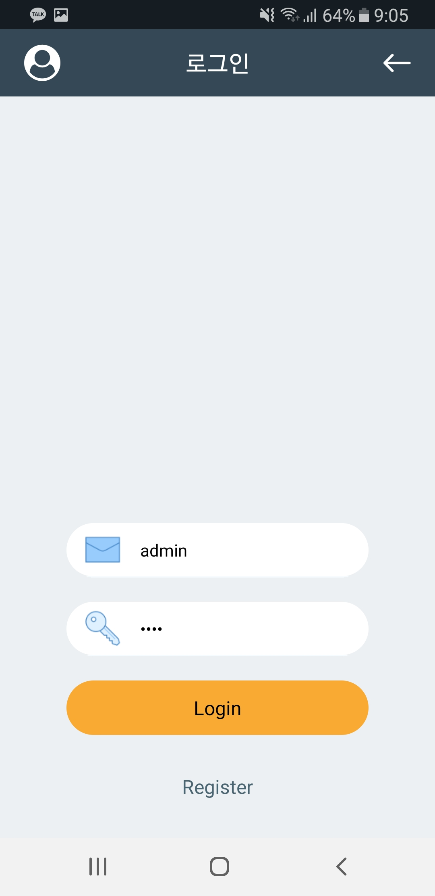
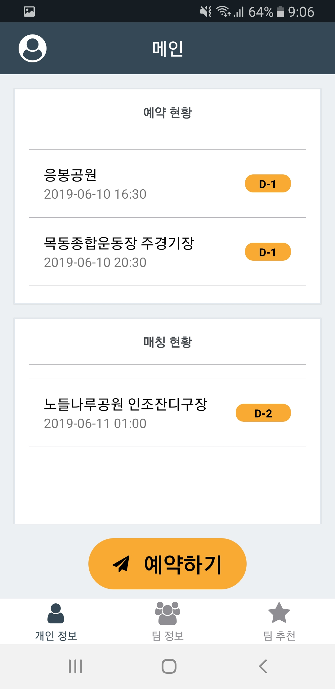
2. Screen Manual : Login
Please enter ID and PWD.
Proceed to login
Go to Membership Screen
1
2
3

Slide 31
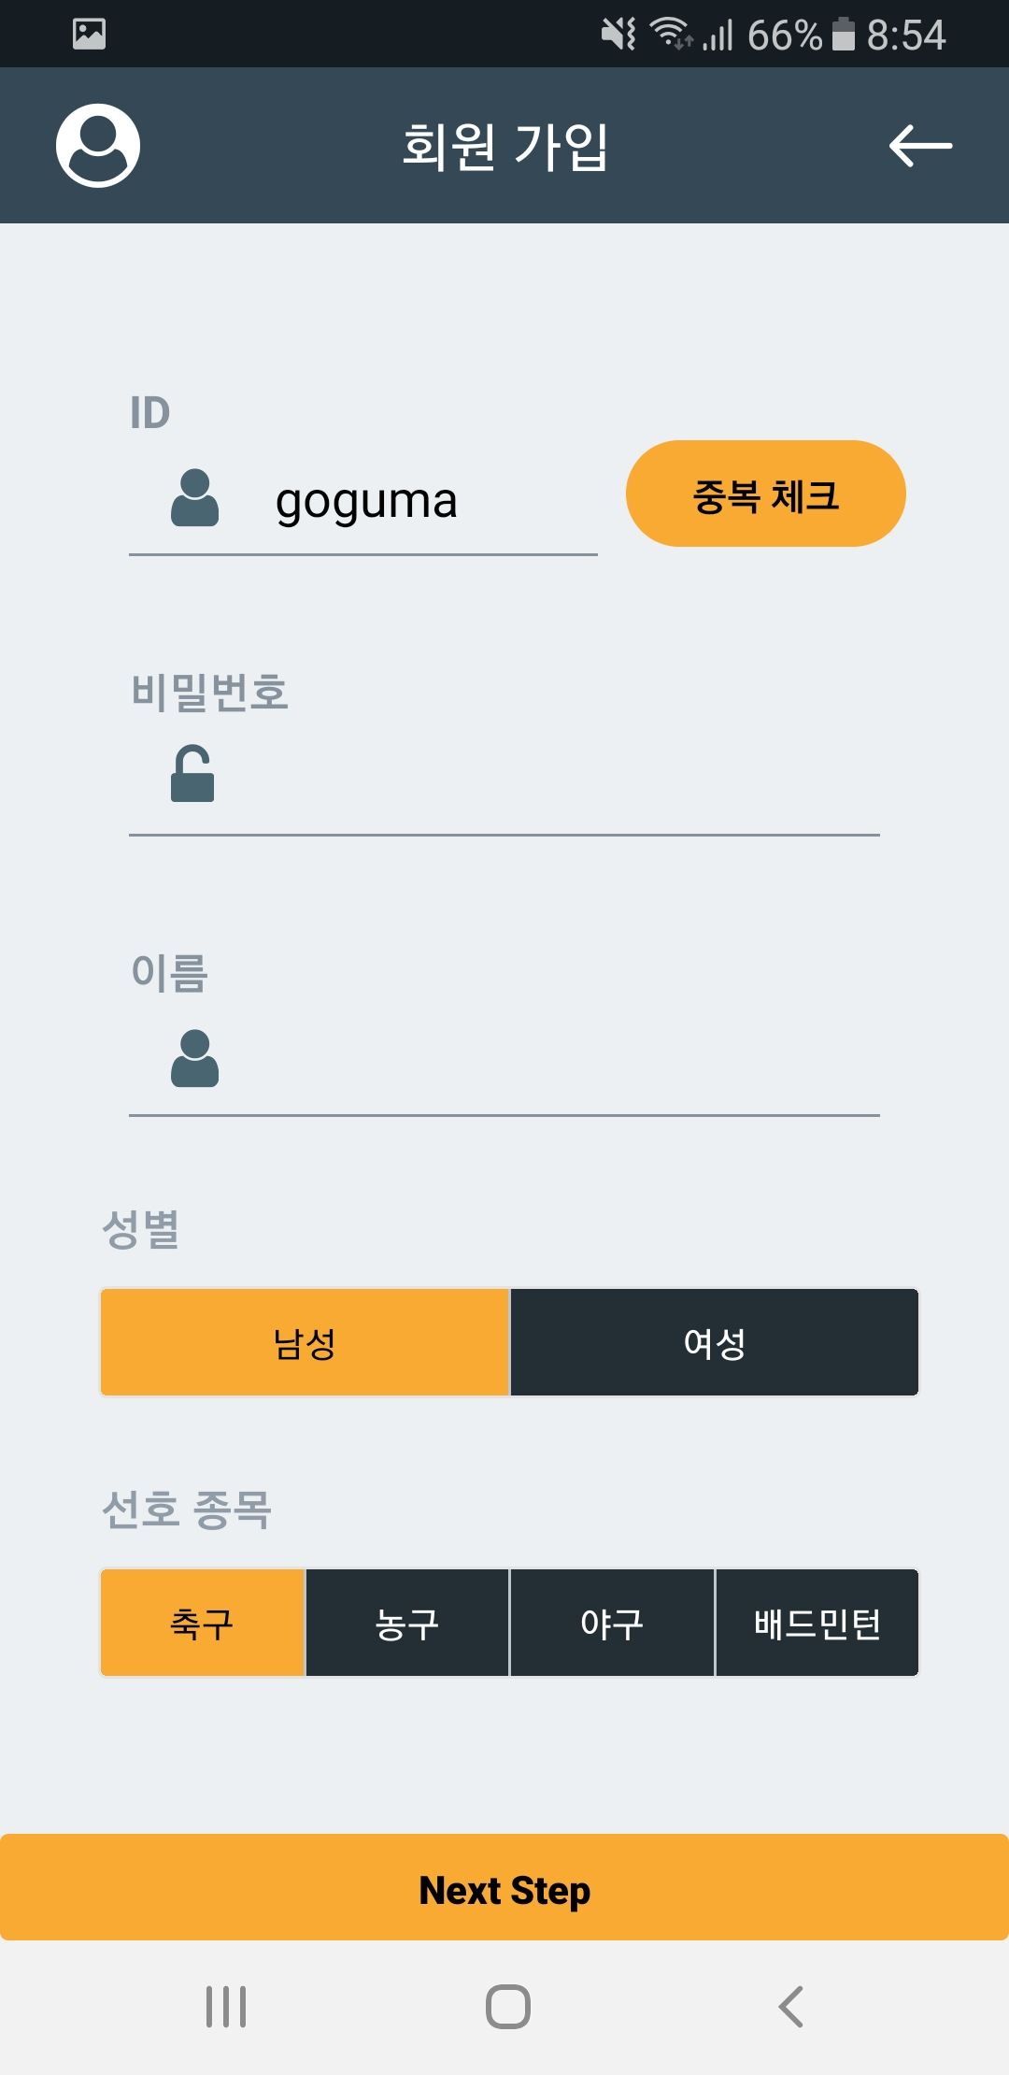
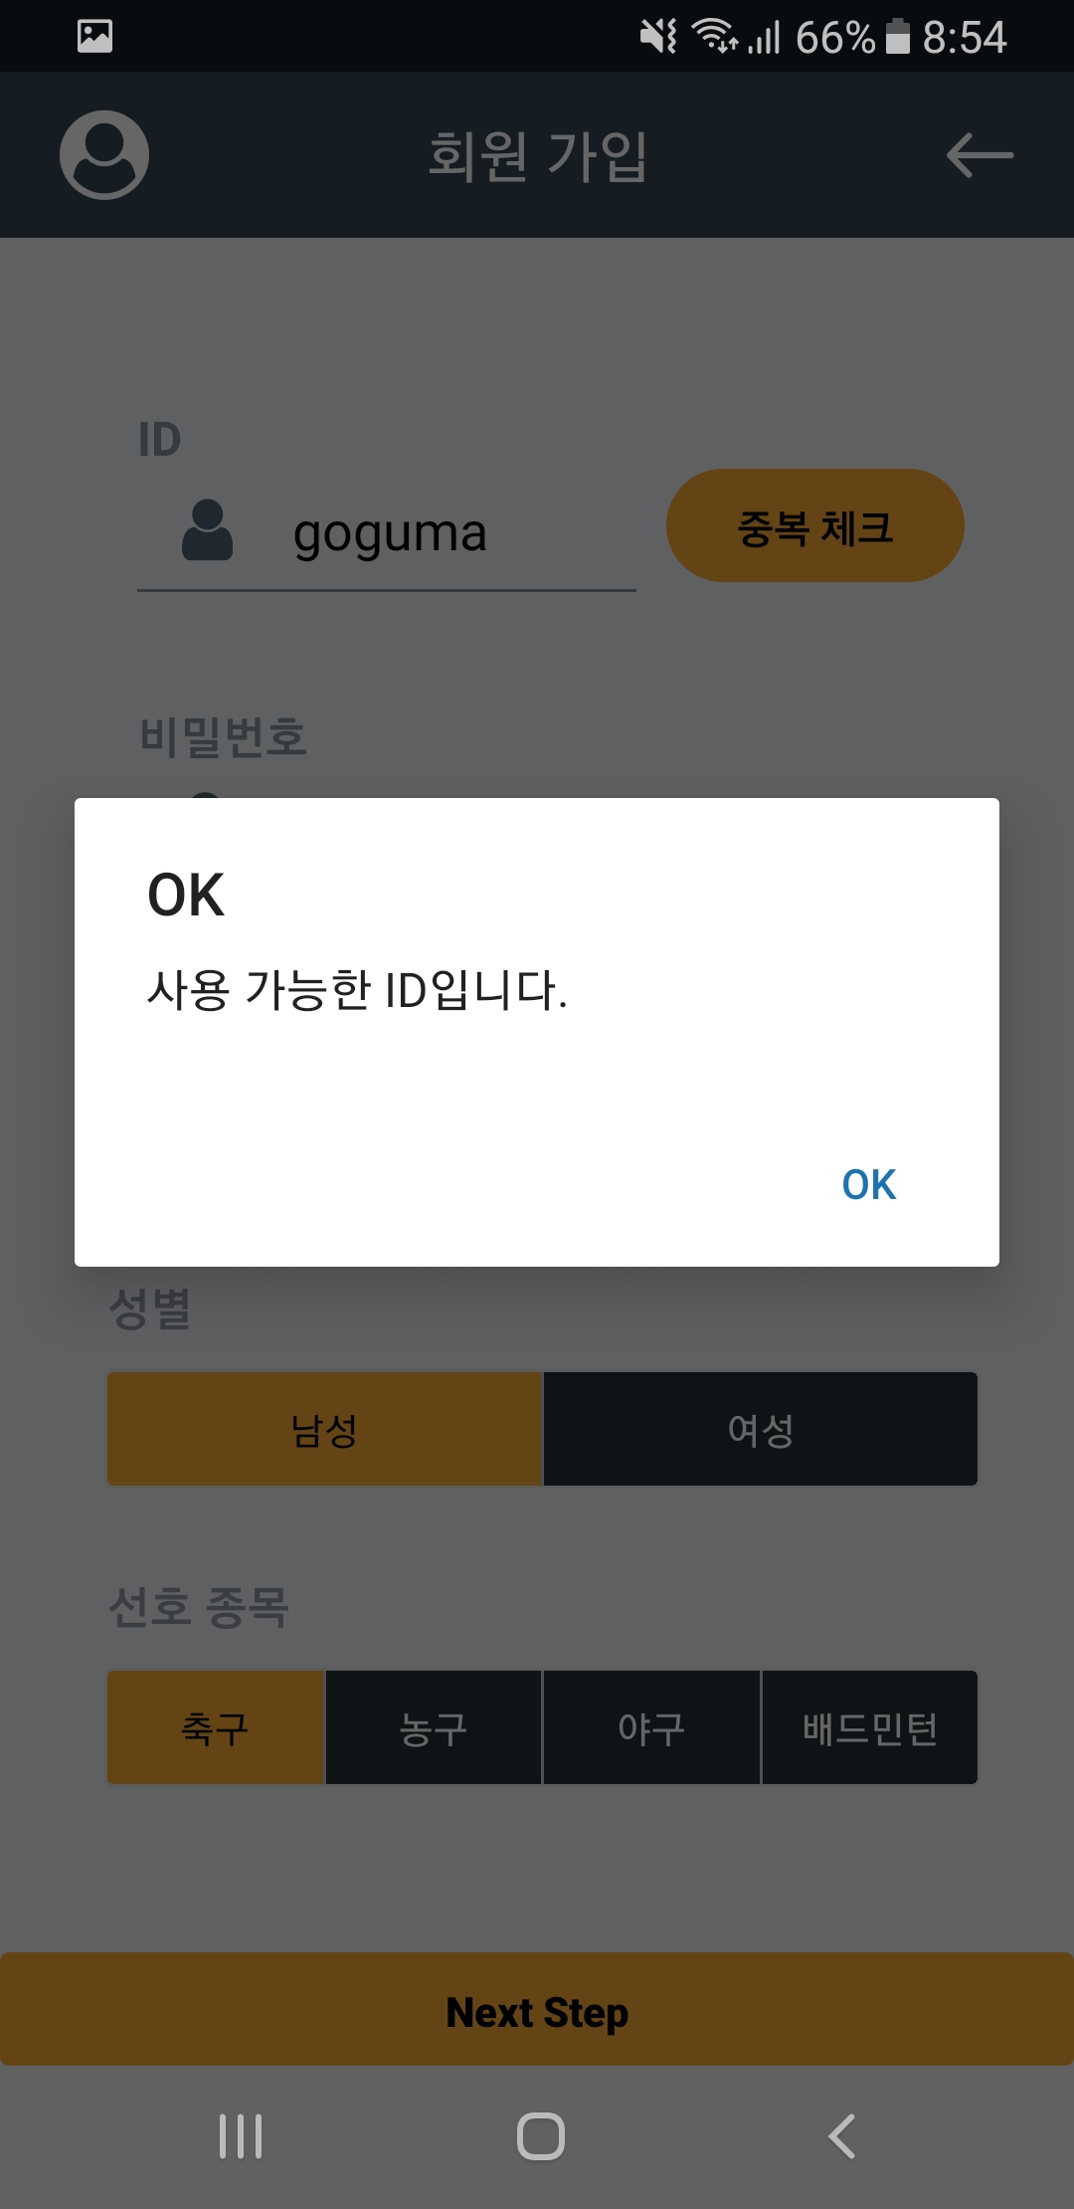

2. Screen Manual : Register
Proceed with duplicate checking for available IDs
1

Slide 32
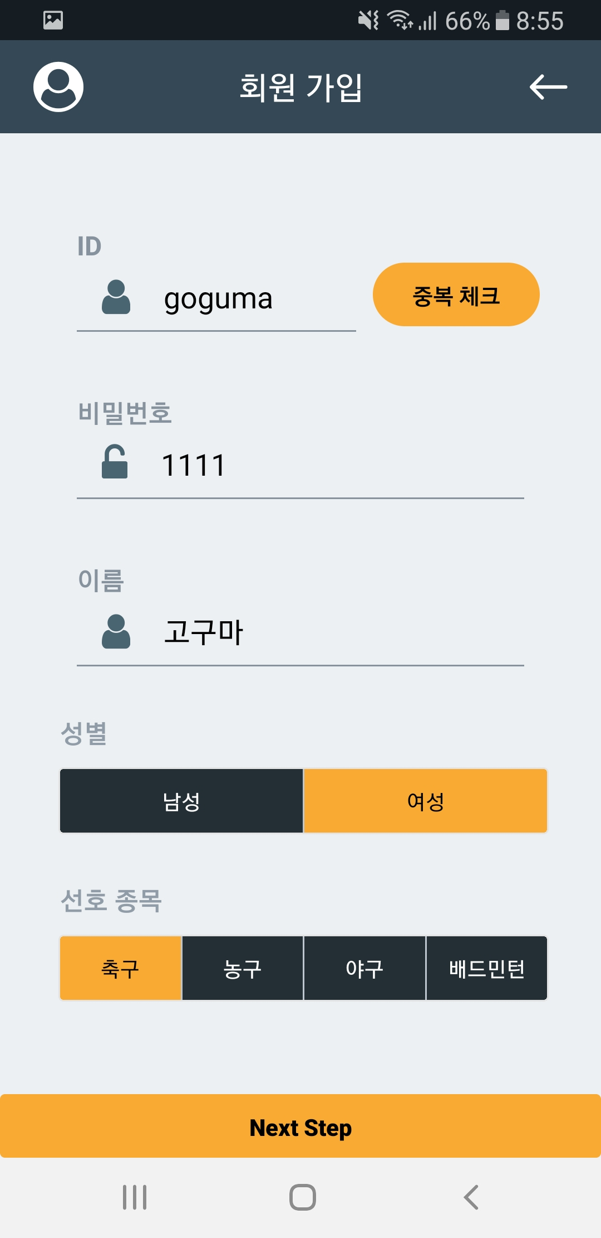
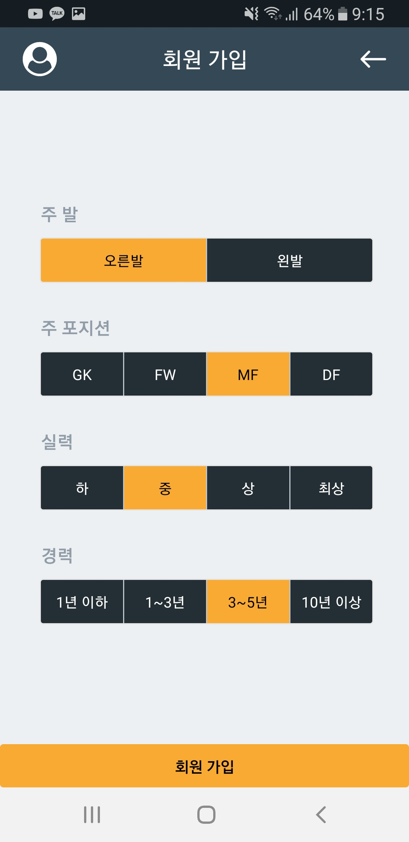
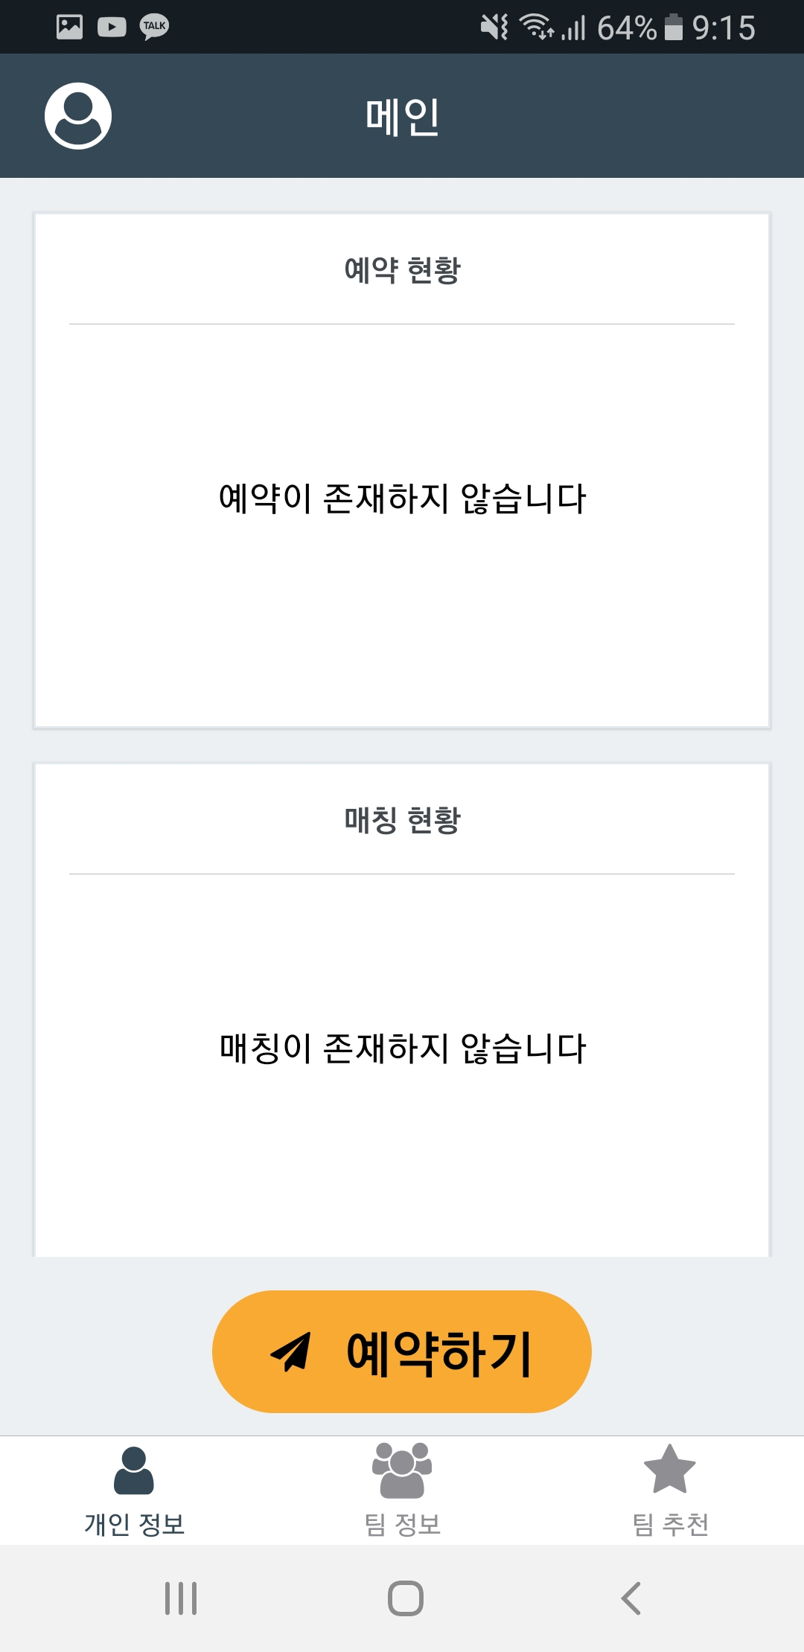
2. Screen Manual : Register
Enter all items and proceed to the next step.
When you are finished, go to the main screen
Please log in.
1

Slide 33
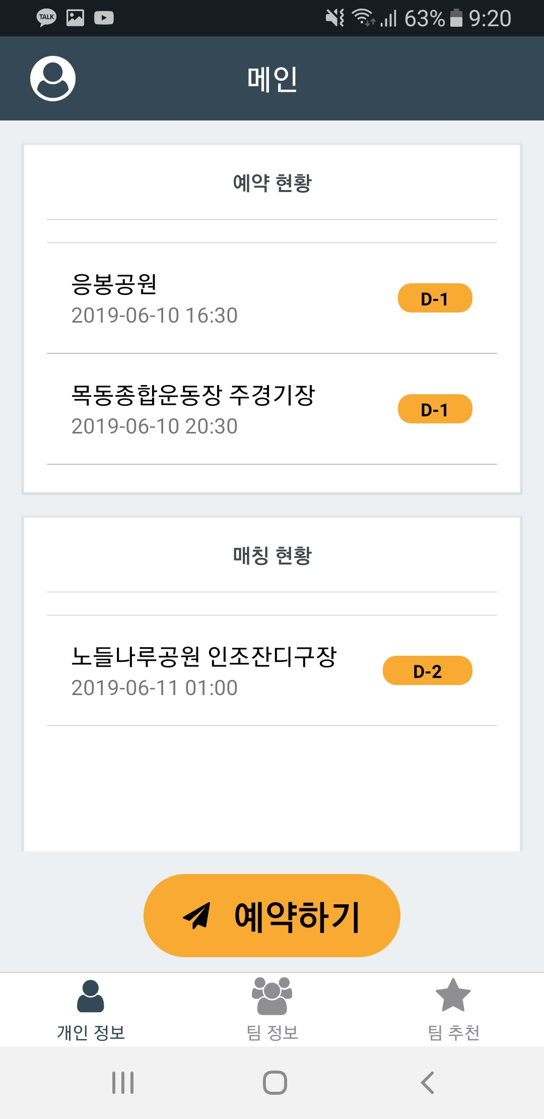
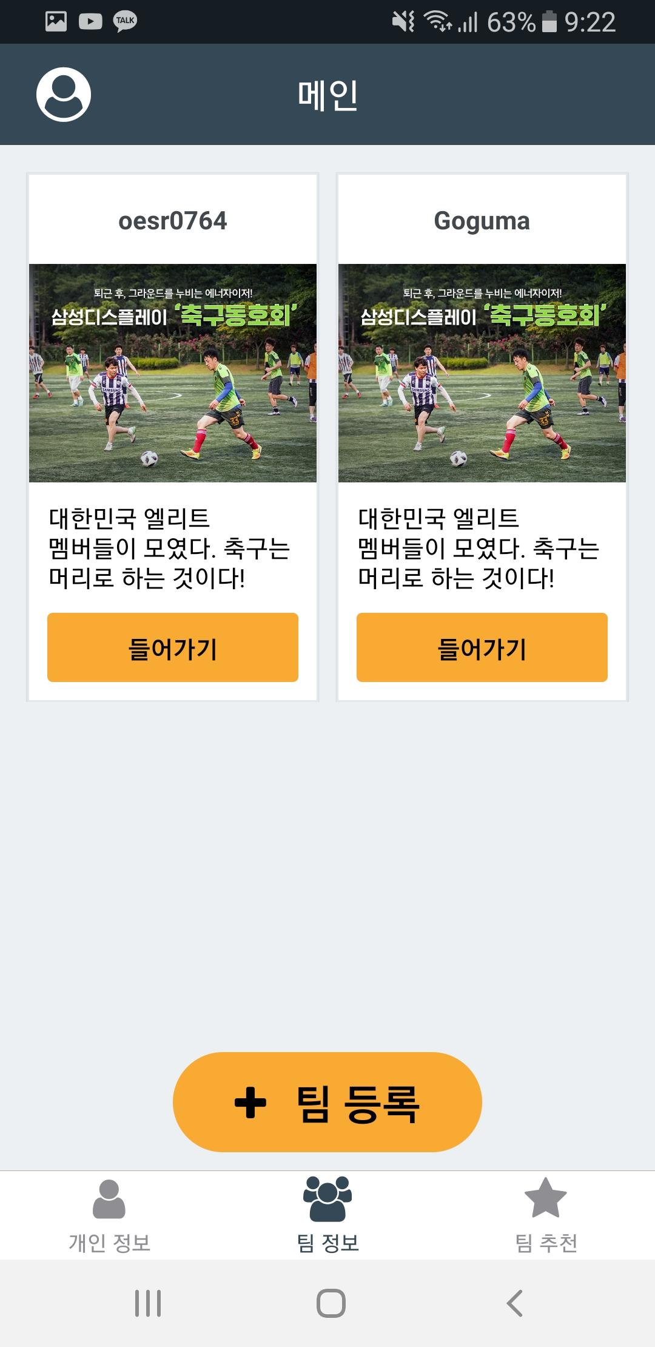
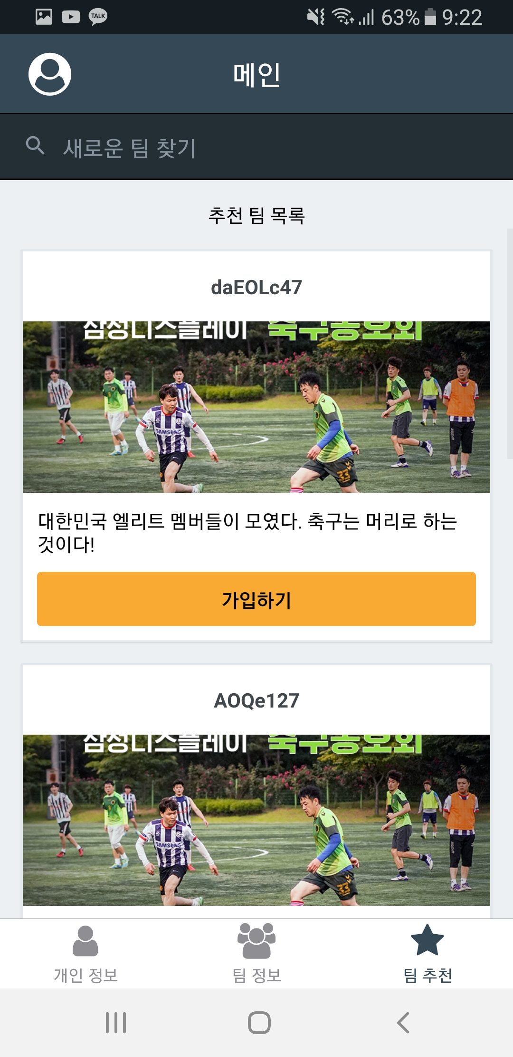
2. Screen Manual : Main
The main screen consists of three tabs: Personal information, Team information, Team recommendation
1
2
3

Slide 34
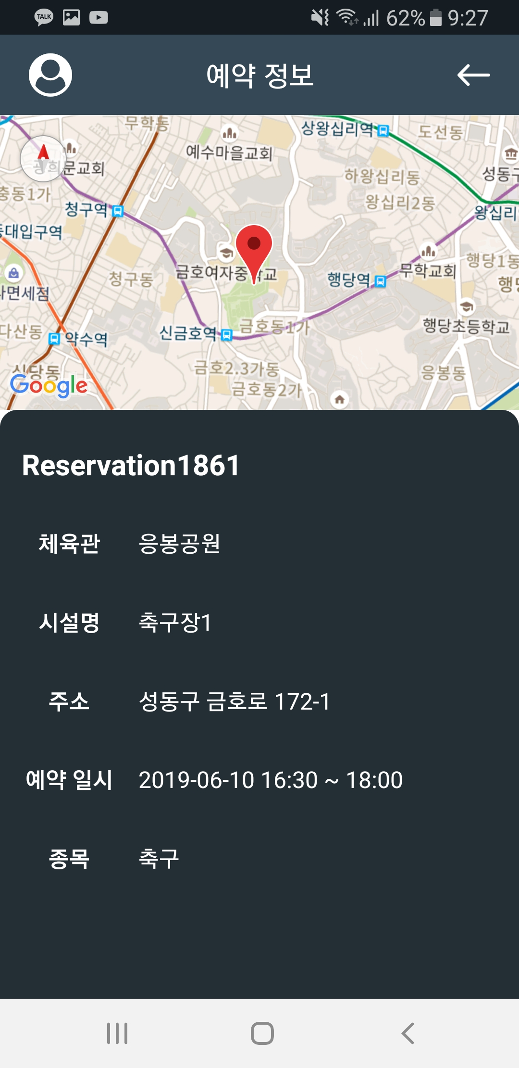
2. Screen Manual : Reservation Status
You can see what your team has booked
The reservation information shows the details of the reservation.
1

Slide 35
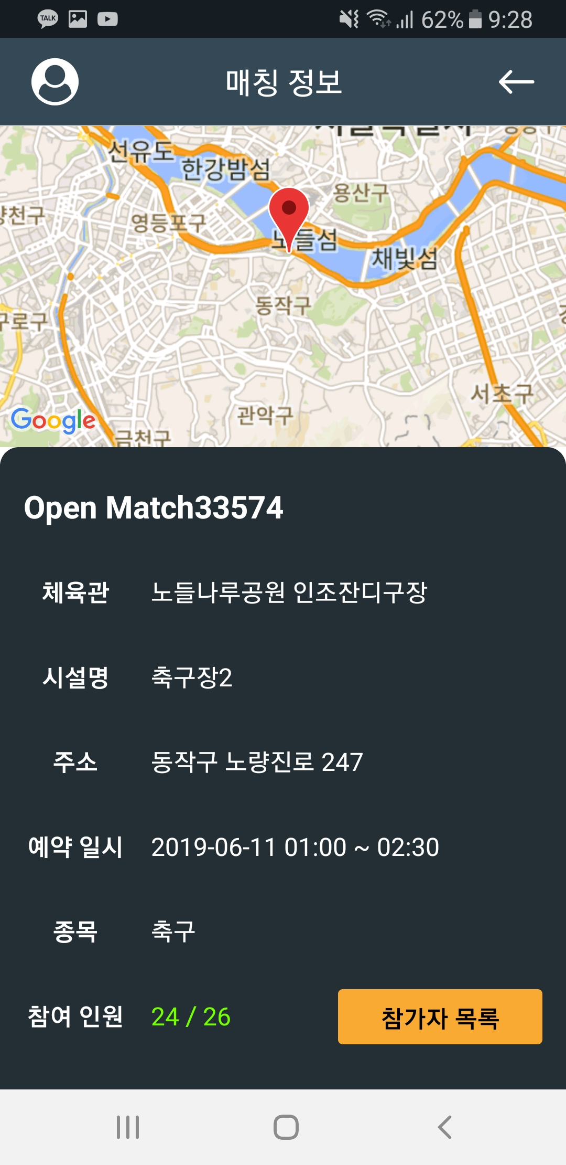
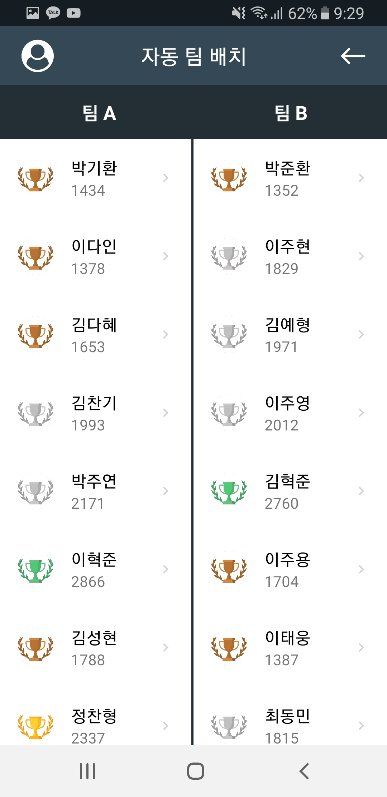
2. Screen Manual : Matching Status
You can see your own matching history
Click on the Participant List to see a list of people who have participated in the match.
It automatically places two teams according to the skill of the participants.
1
2

Slide 36
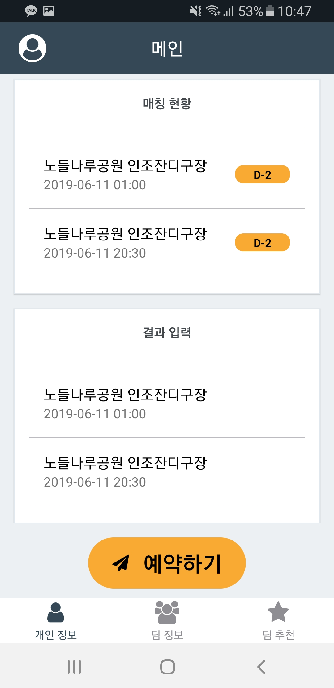
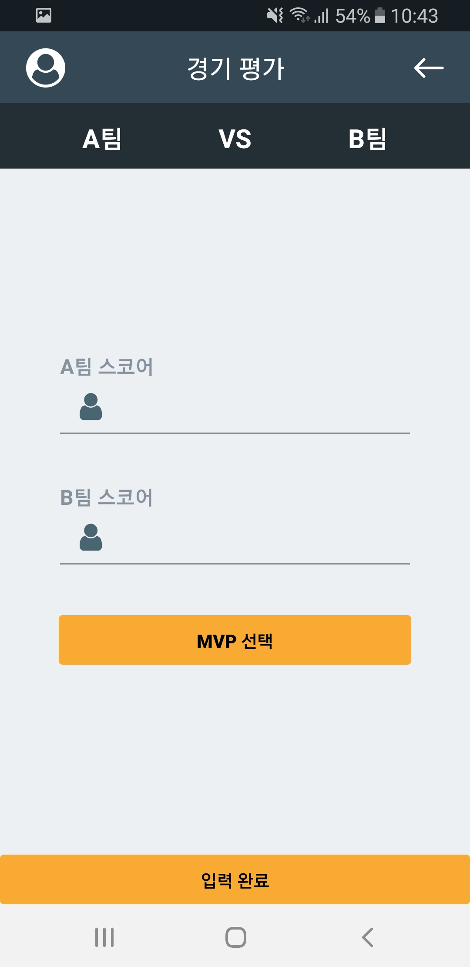
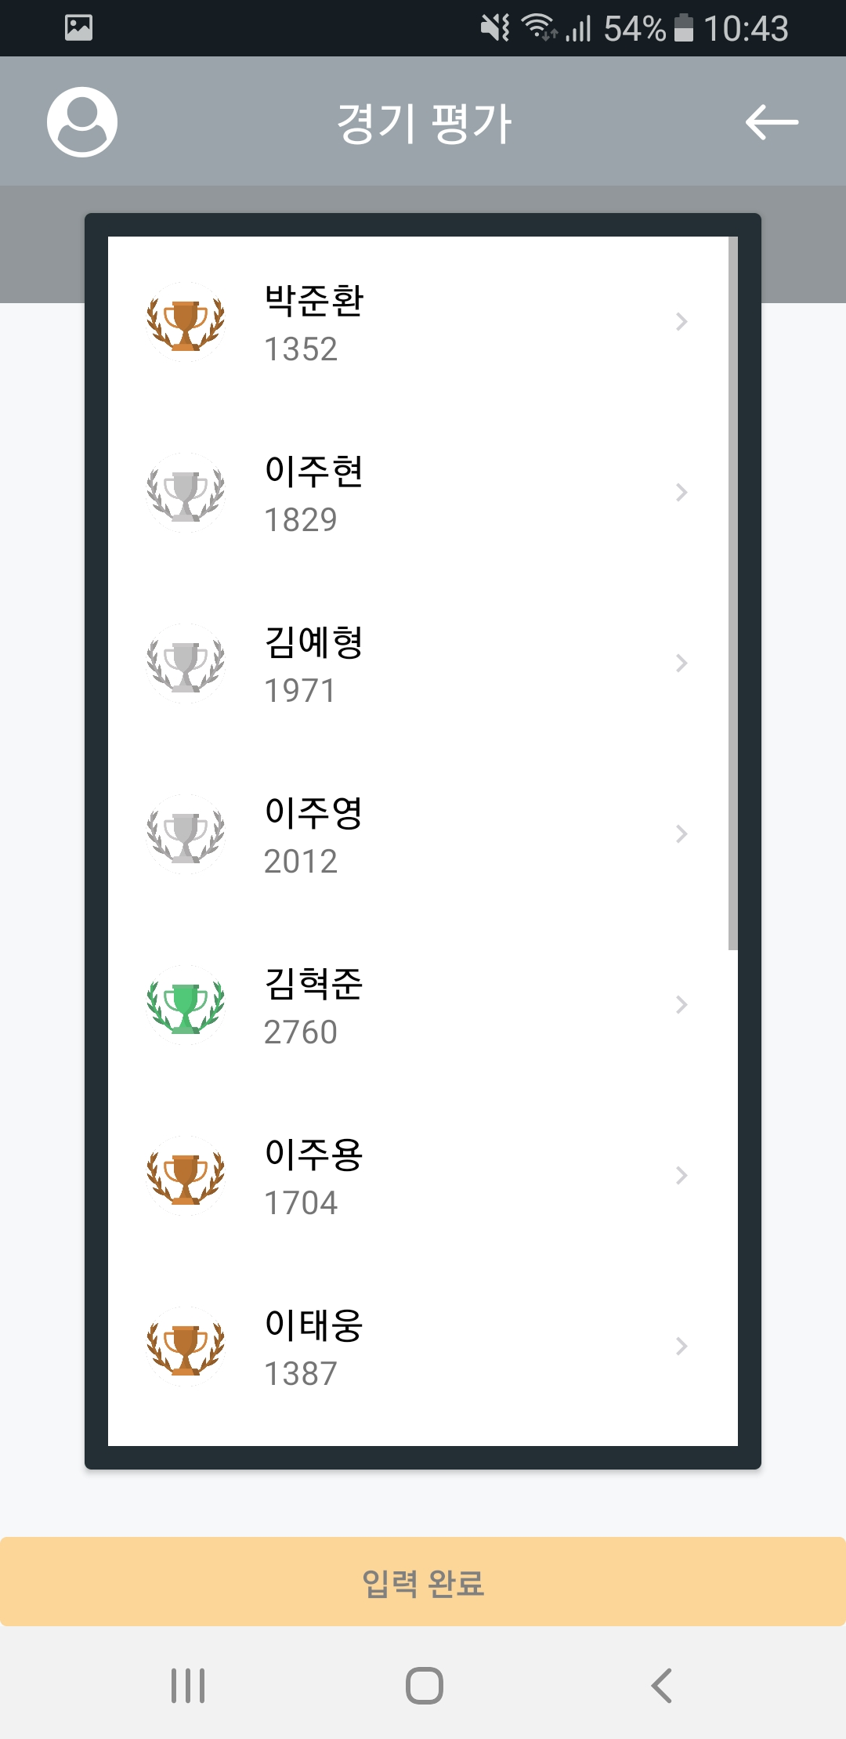
2. Screen Manual : Result Evaluation
Enter the results of the match and reflect on the individual and team performance
Choose match score and MVP
Click the Done button to submit
1
2
3

Slide 37
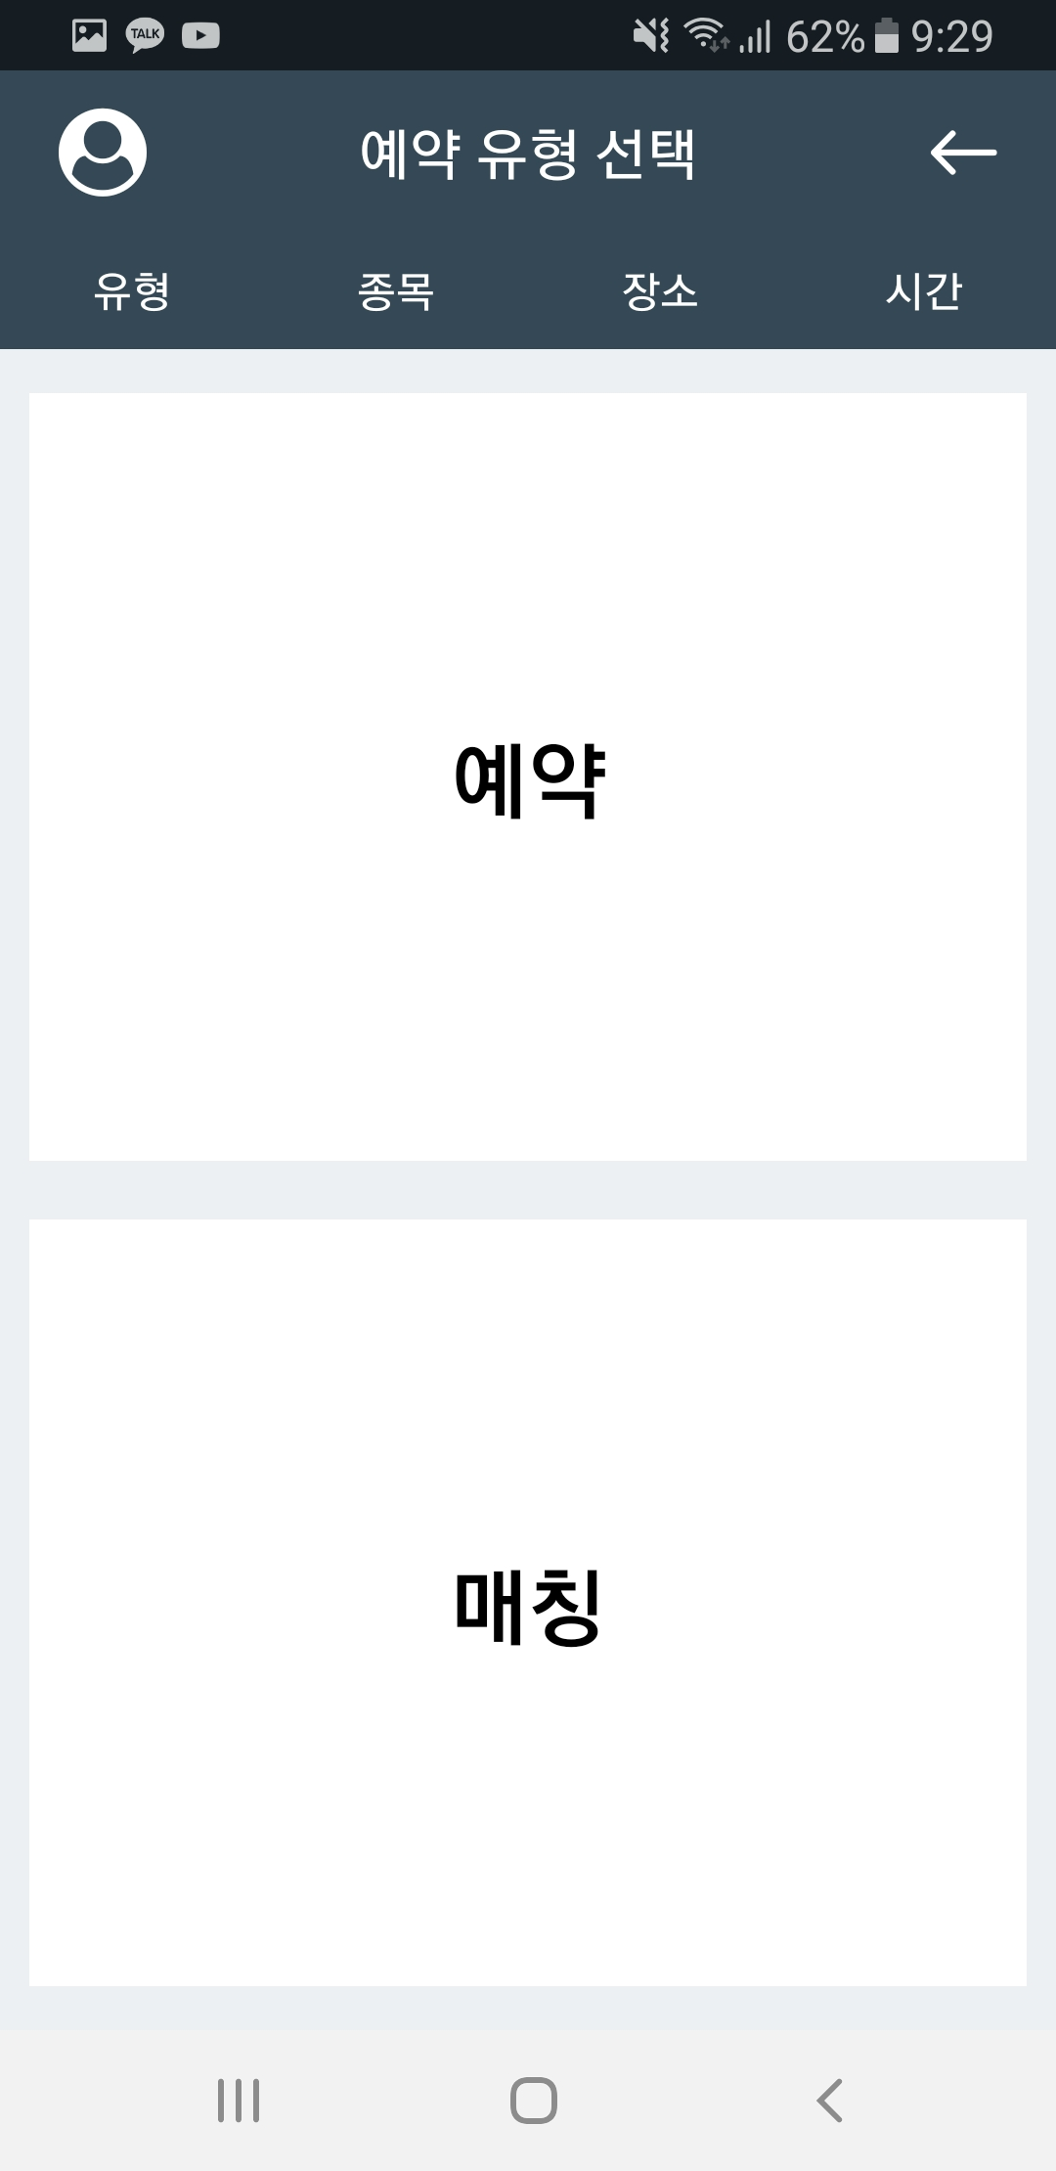
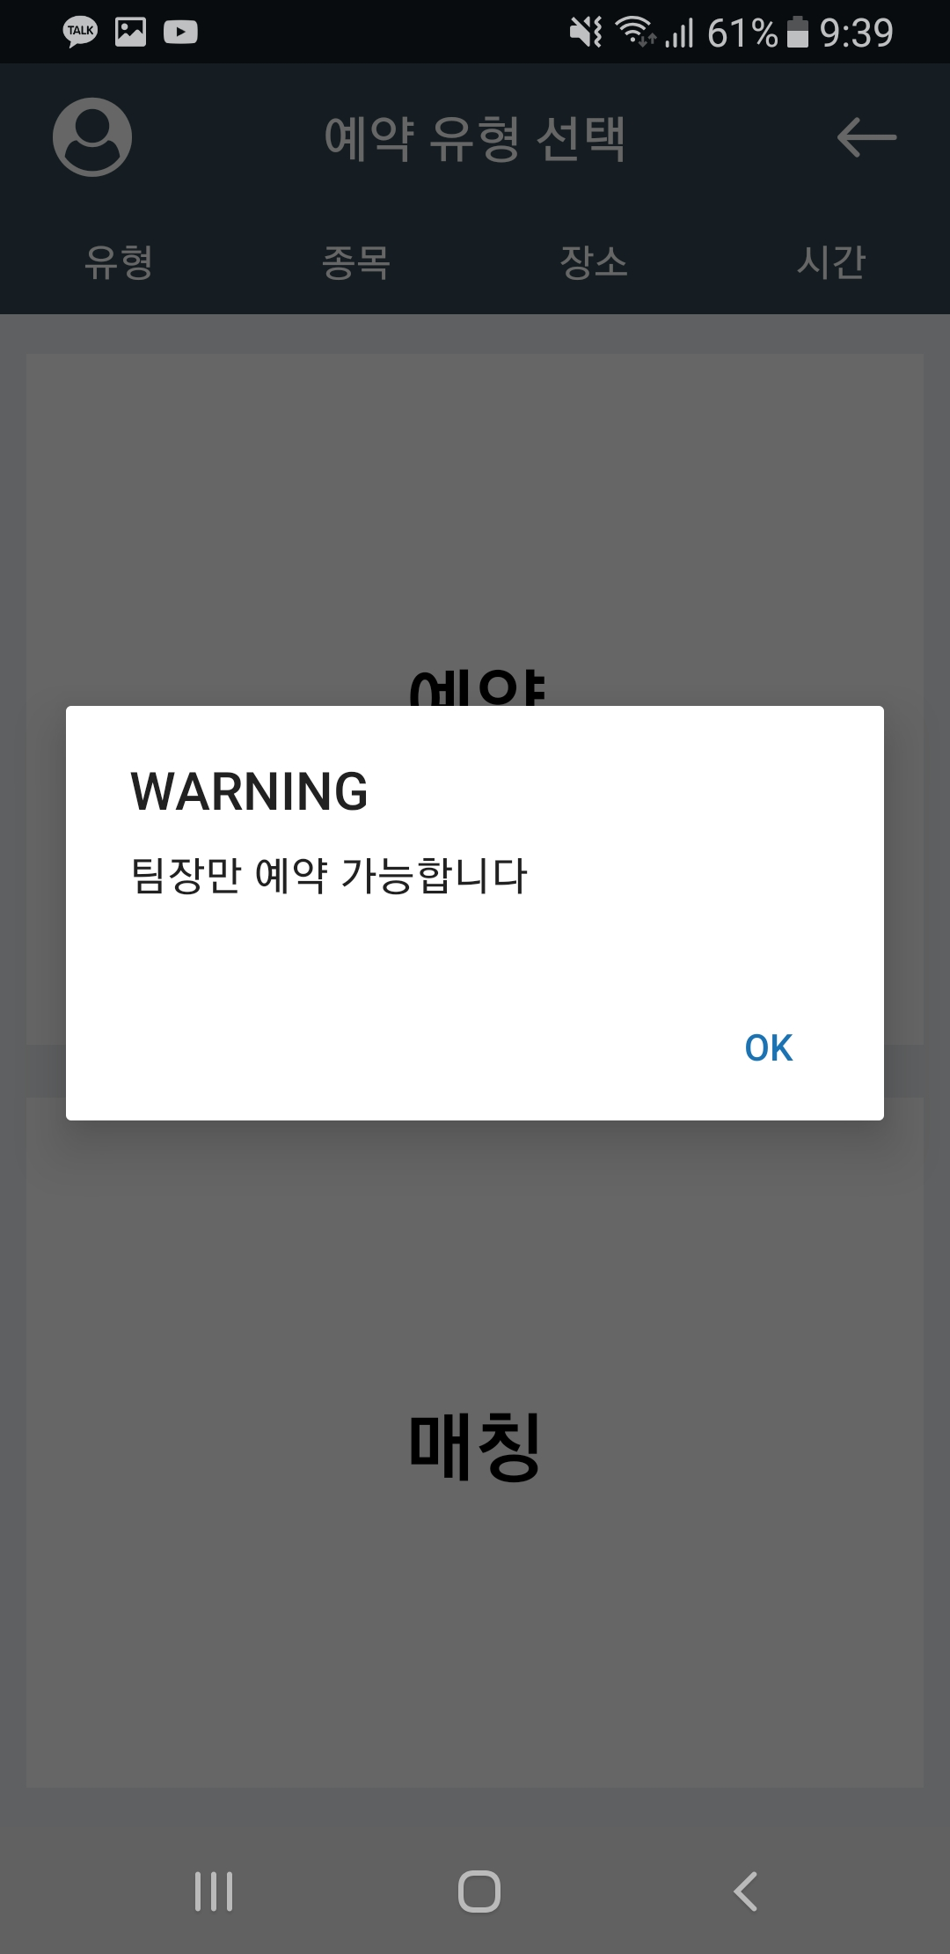
2. Screen Manual : Reservation
You can schedule a reservation or match by clicking the Schedule button
Reservations can only be made by the team leader.
If you want to make a reservation, please create a team
2
1

Slide 38
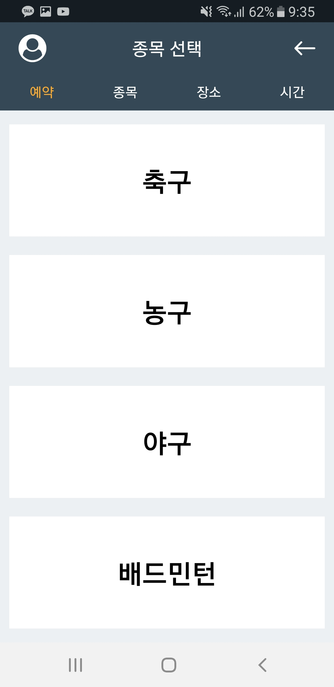
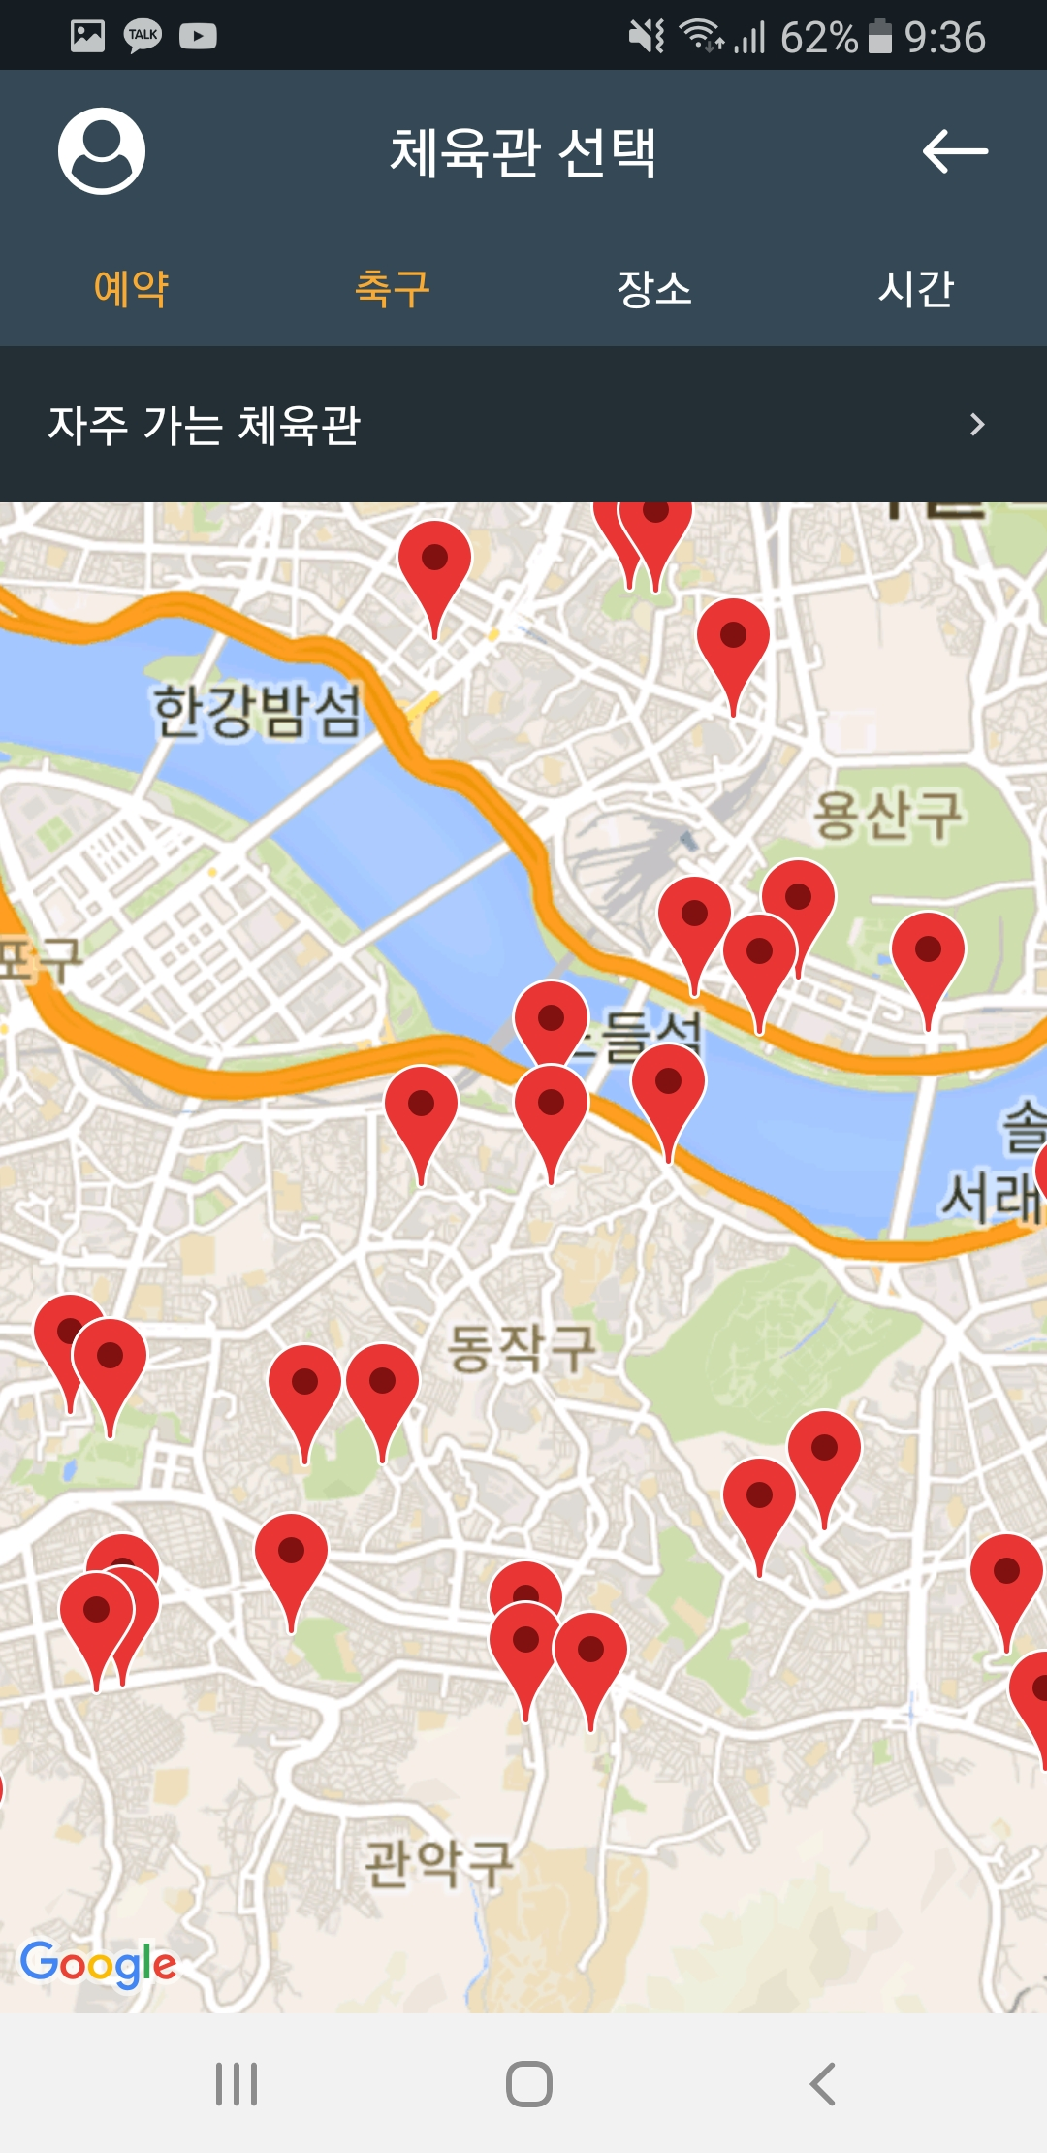
2. Screen Manual : Reservation
Team leaders can make reservations.
Please select an item
Please select a gym
The top status bar shows your selections
1
2
3

Slide 39
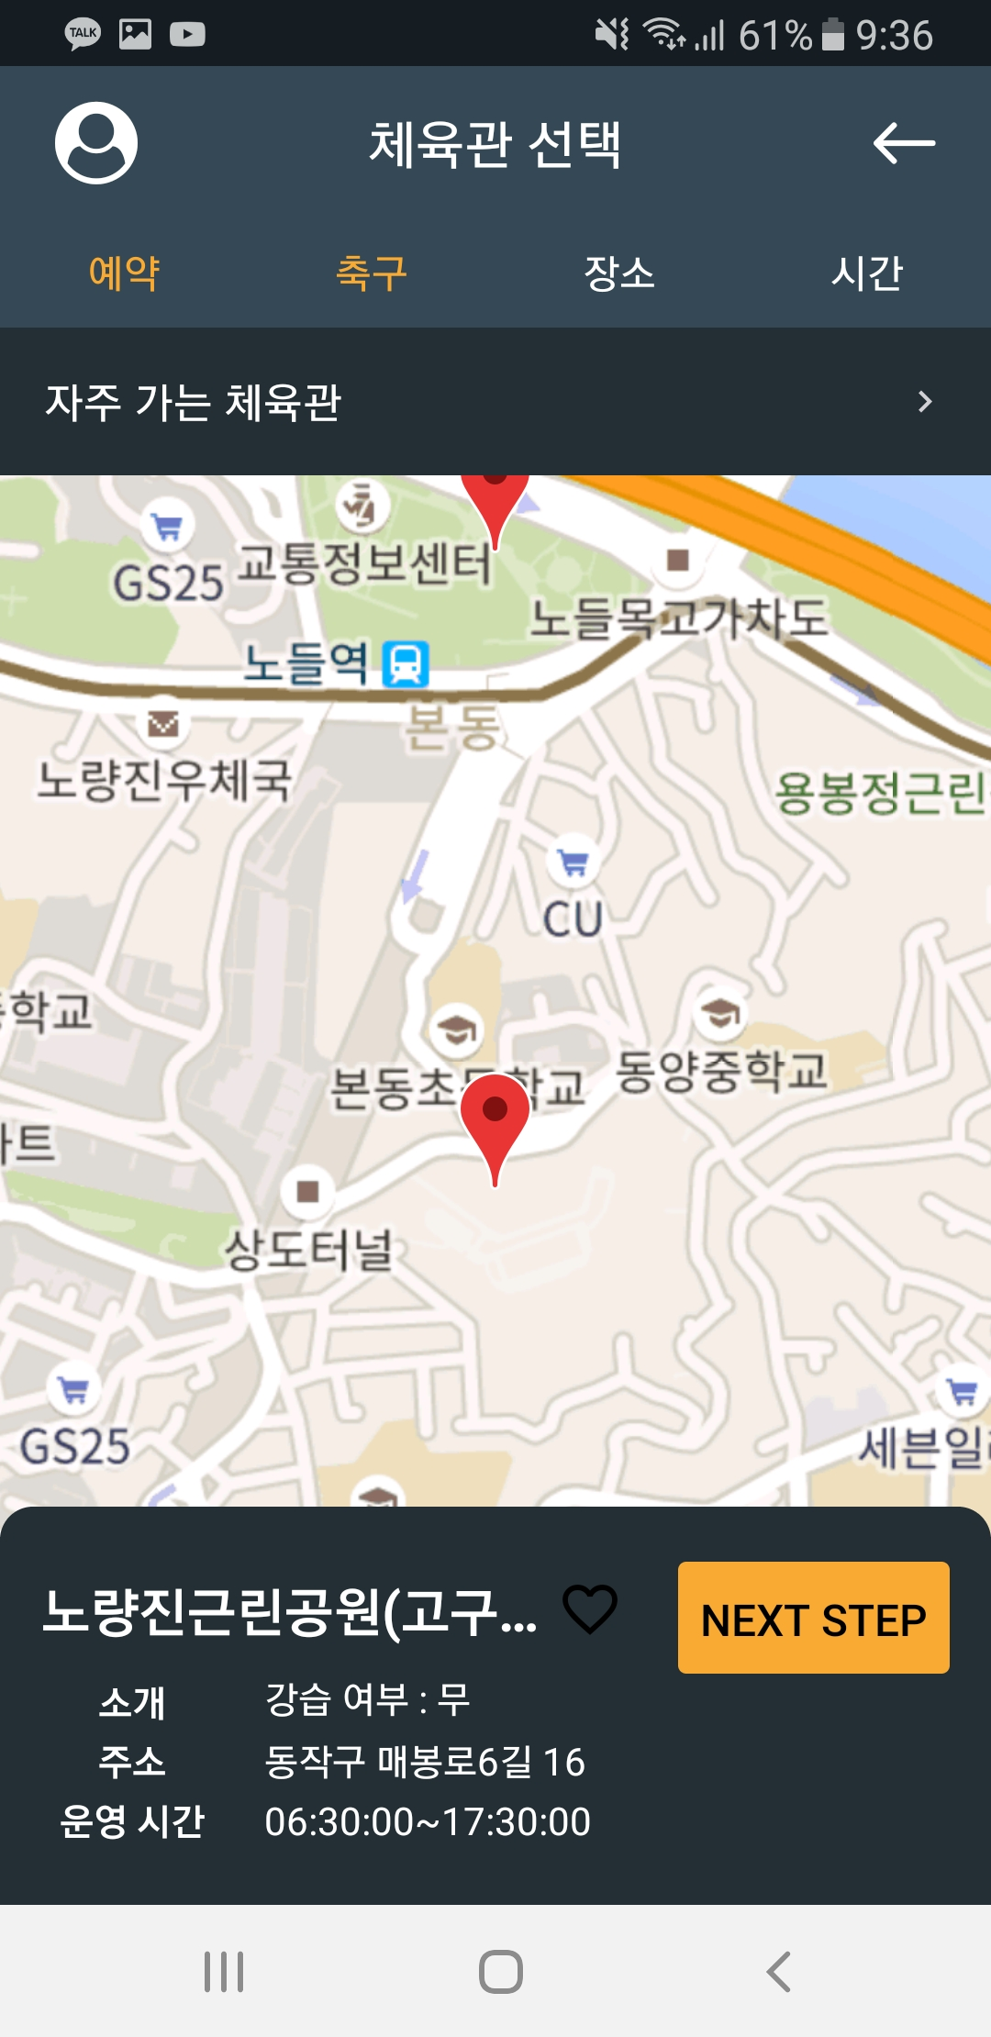
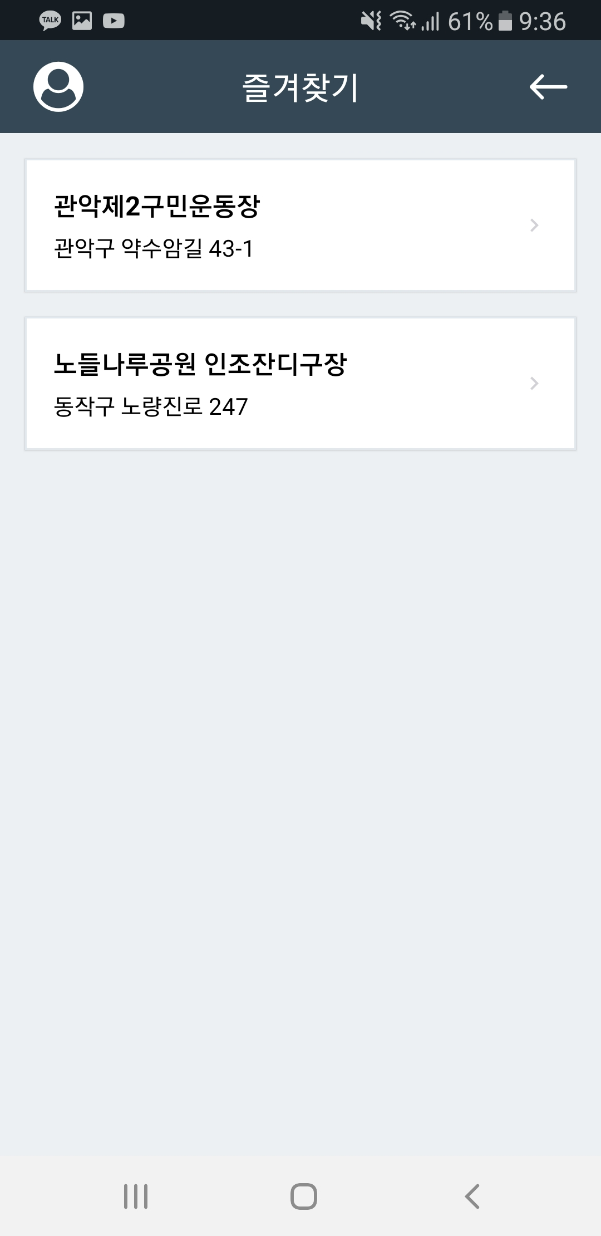
2. Screen Manual : Select Gym
There are two ways to choose a gym.
Click on the marker on the map to select a gym
Find a list of favorite gyms
2
1

Slide 40
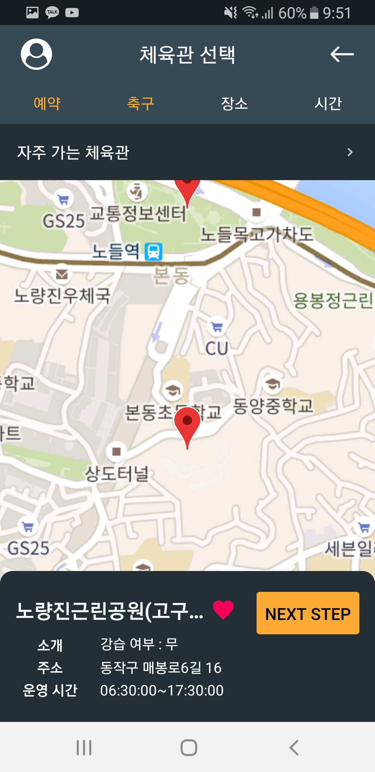
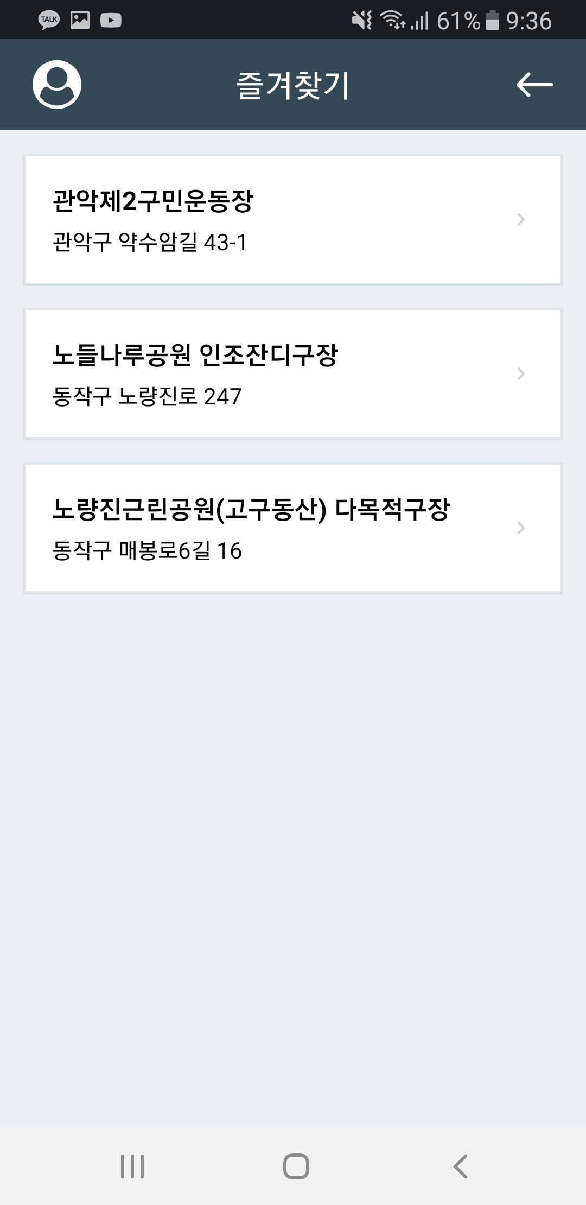
2. Screen Manual : Favorite Gym
You can add it to your favorites by clicking the Heart button in the gym info.
1

Slide 41
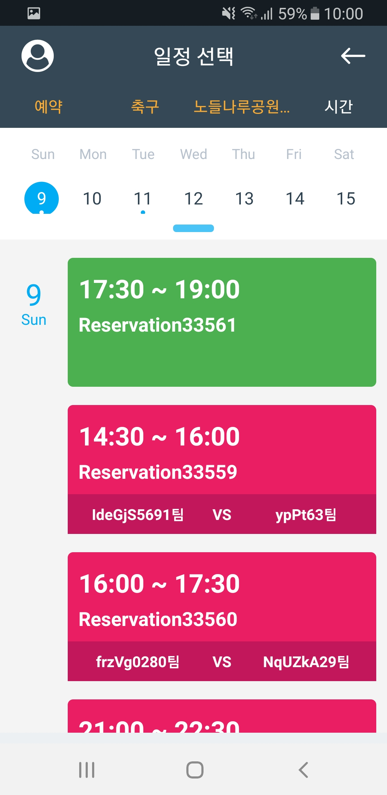
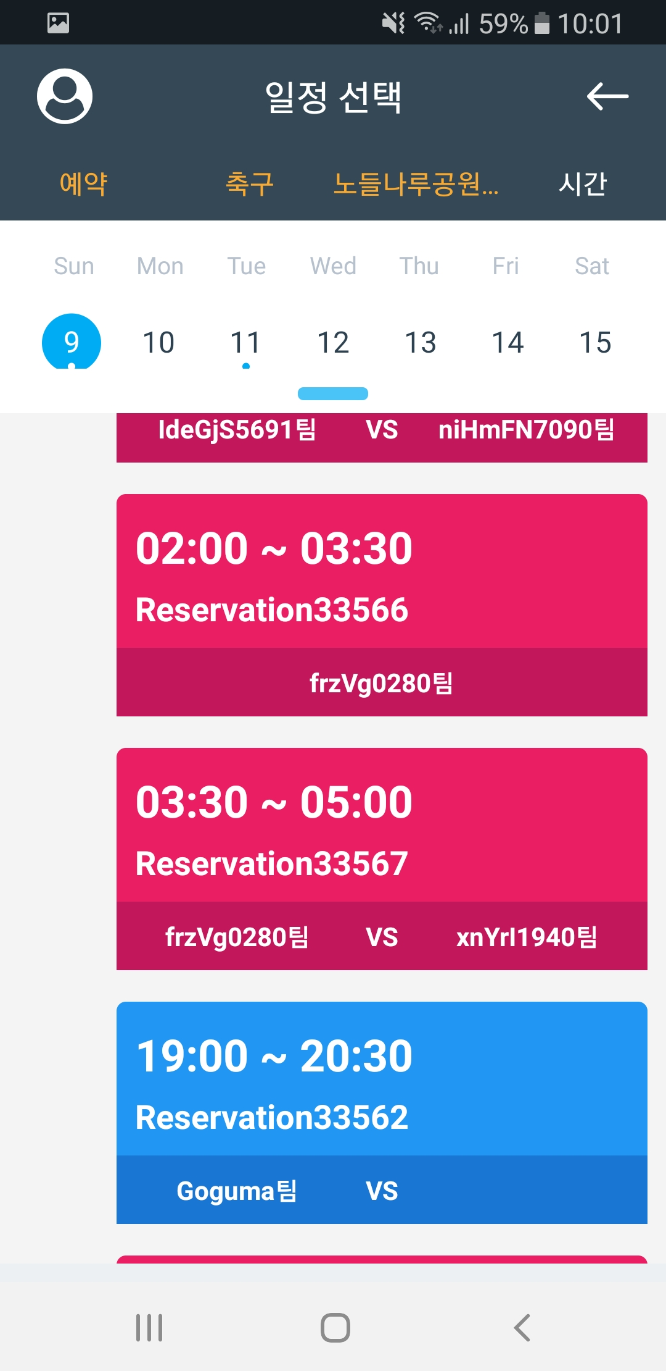
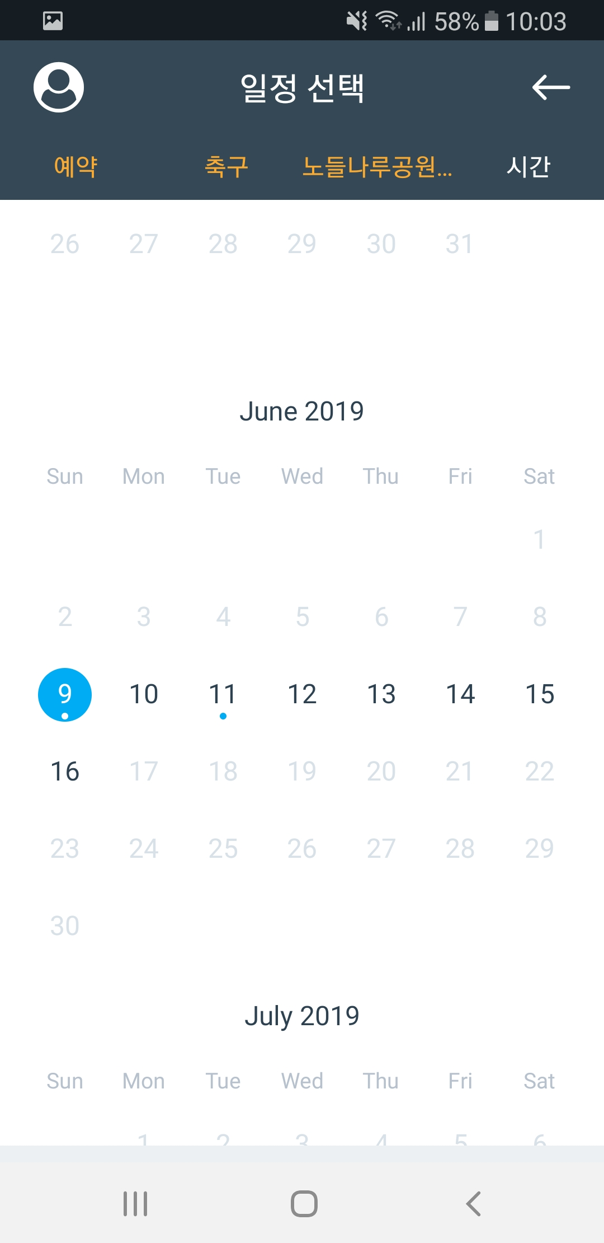
2. Screen Manual : Select Plan
There are four types of schedule.
Empty schedule
Reserved schedule (play with my team)
Reserved schedule (Allow Join + waiting for opponents)
Reserved schedule (Allow Join + opponent's participation completed)
You can check the entire schedule by lowering the top bar
6
2
3
5
8
4

Slide 42
2. Screen Manual : Select Plan
Reservations can only be made after a maximum of one week
If available reservations are present, they are displayed below the date
6
2
3
5
8
4

Slide 43
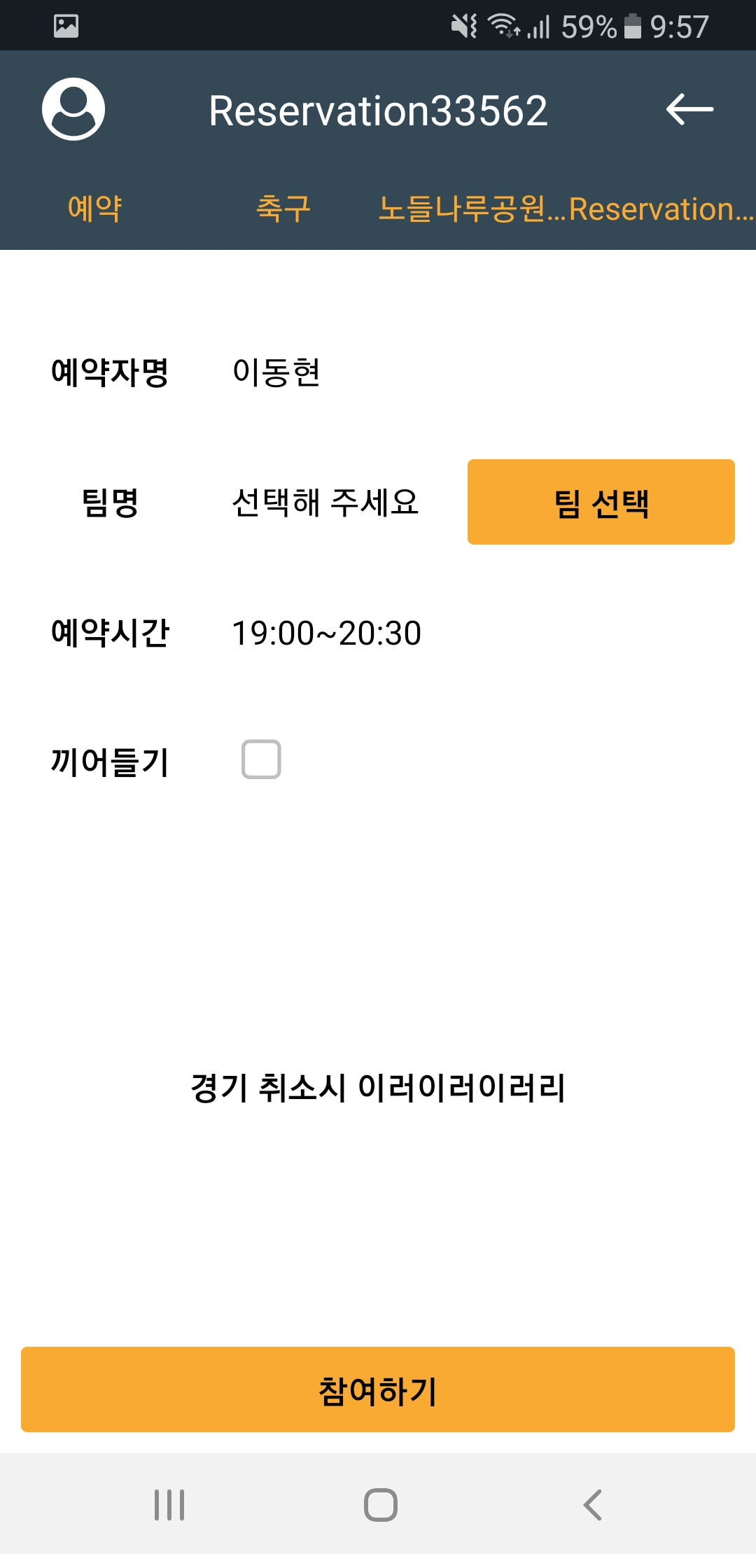

2. Screen Manual : Empty Plan
Schedule an empty schedule
Since you can be the team leader for multiple teams, you need to choose which team you want to schedule
1
2

Slide 44


2. Screen Manual : Empty Plan
If you do not select a team, the following alert window appears
If you do not allow interrupts, only your team can use it
If you allow, you can play with other teams
Click the Join button to complete the booking
1
2
3
4

Slide 45

2. Screen Manual : Join Plan
You can join on a schedule that other teams are allowed to join
You can see the profile of the team you have booked
Since you can be the team leader for multiple teams, you need to choose which team you want to schedule
Click the Join button to complete the booking
2
3
1
4

Slide 46


2. Screen Manual : Matching
This is how to schedule a match.

Slide 47



2. Screen Manual : Matching Plan
Matching must be confirmed to meet minimum requirements
The number of applicants / maximum number of persons can be confirmed by the background color
You can see a list of participants
2
1
3

Slide 48


2. Screen Manual : Search Join Member
You can search for members in the search bar
Members with search strings are listed
Click Members to view your personal profile
1
2
3

Slide 49


2. Screen Manual : Member Profile
1
Go to profile screen
You can see your rank and MMR
You can see achievements based on number of games, odds, and MVP points
You can see the number of matches played per month
4
2
3
5
6

Slide 50
2. Screen Manual : Member Profile
1
You can see your current ranking, and you can also slide to see members in your neighborhood rankings
If it is a My Page, the Logout button is enabled
4
2
3
5
6

Slide 51


2. Screen Manual : Register Team
You can register a new team by clicking the Team Registration button on the Team Info tab
Proceed with a duplicate check to see if it is an available ID
Click the Register button to create a new team
2
1
3

Slide 52



2. Screen Manual : Team Profile
Once you select a team, you will be taken to the team profile screen
Team Info / Competition / Team Info Three tabs
You can see your team's rank and MMR
You can see achievements based on number of matches, odds, and number of team members
5
1
3
4
6
2

Slide 53
2. Screen Manual : Team Profile
You can see how many games a team has played each month
You can see your current position on the team, and you can also slide to see the members in your neighborhood rankings
5
1
3
4
6
2

Slide 54


2. Screen Manual : Team Profile
On the Match Result tab you can see the latest winning ratio and results
On the Team Members Info tab, you can see a list of team members and click to go to your personal profile screen
1
2

Slide 55



2. Screen Manual : Recommend & Search Team
The team recommendation screen recommends the right team based on your own MMR
There is also the ability to search for teams
2
1

